Slide 1

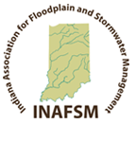
ASFPM Foundation
INAFSM 2019 Annual Conference
Indiana Association of Floodplain and Stormwater Management
September 4-6, 2019
Fort Wayne, Indiana
Notes:
Give a short bio of myself
How many of you have heard of the ASFPM Foundation?
This short presentation will help answer questions on the purpose and what the ASFPM Foundation does.

Slide 2


ASFPM Foundation
Our Vision
The ASFPM Foundation is dedicated to reducing the risk and impacts of floods on people and communities.
Our Mission
The ASFPM Foundation serves as the catalyst for ASFPM, its chapters and members to advance projects, education and policy initiatives that promote reduced flood risk and resilient communities.
Notes:
The ASFPM Foundation is a Nonprofit 501(c)(3) organization, separate from ASFPM.
The ASFPM Foundation assists ASFPM in accomplishing its mission.
Hold up 2018 Donor Report.

Slide 3
Who We Are…
Trustees
Associates
Fellows
Executive Office
…. and Most Important
Donors
Notes:
1. The ASFPM Foundation Officers and Board consist of corporate employees and retirees.

Slide 4
A shout out for …
Thank You INAFSM for your previous donations to the ASFPM Foundation.
Notes:
Chapter has provided $3,590 in previous donations.

Slide 5
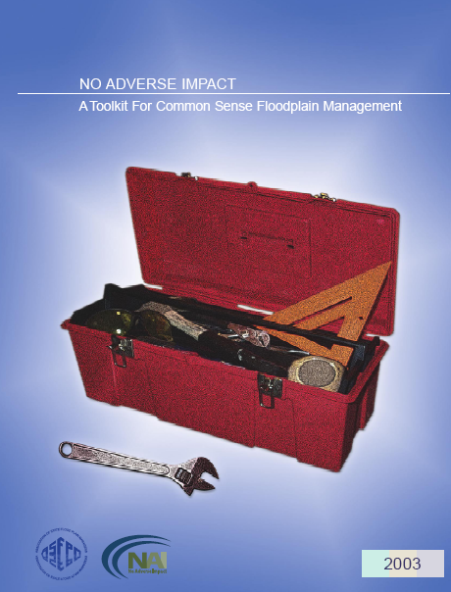






What YOU Fund…
Policy and Technical Dialog
Education
Scholarships
Projects
4 Forums
11 Symposia
LAL Speaker’s Series
Auctions
Notes:
These are the major activities, projects, and events funded by the ASFPM Foundation.
The source of funding for these ASFPM Foundation activities, events, and projects is primarily from donations.

Slide 6
Events Committee
Facilitating Policy Dialog
12 Chapter Symposia
Larry Larson Speaker Series
Gilbert F. White Policy Forums and Reports
4 Forums
11 Symposia
LAL Speaker’s Series
Auctions

Slide 7
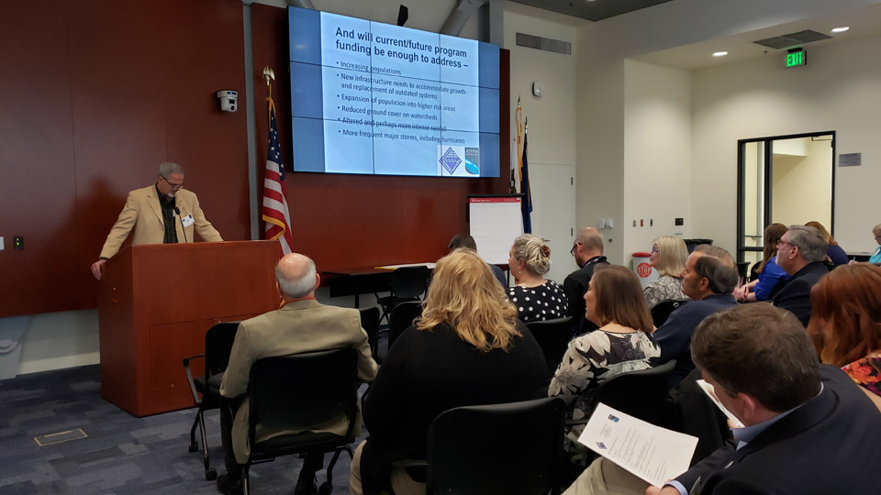
State Flood Risk Symposium
State Flood Risk Symposium
Co-hosted by Floodplain Management Association (CA, HI, NV): April 2019, Sacramento, CA
Notes:
Started in 2011
12 State Symposia have been held
Indiana Chapter held the first State Symposium on April 12, 2011. Based off of the March 10, 2018 Gilbert F. White National Policy Forum: “Managing Flood Risks and Floodplain Resources.”
State Symposia based on needs and topics at State level
2019 State Symposium was held with FMA Chapter (CA, NV, and Hawaii)

Slide 8
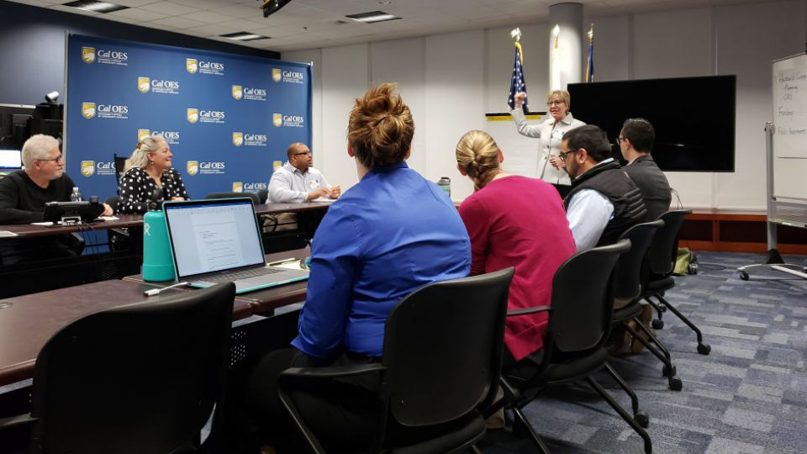
State Flood Risk Symposium
State Flood Risk Symposium
Co-hosted by Floodplain Management Association (CA, HI, NV): April 2019, Sacramento, CA
Notes:
Started in 2011
12 State Symposia have been held
Indiana Chapter held the first State Symposium on April 12, 2011. Based off of the March 10, 2018 Gilbert F. White National Policy Forum: “Managing Flood Risks and Floodplain Resources.”
State Symposia based on needs and topics at State level
2019 State Symposium was held with FMA Chapter (CA, NV, and Hawaii)

Slide 9
Events Committee
Larson Speaker Series- Big Data and Flood Risk
GFW Forum- Urban Flooding
4 Forums
11 Symposia
LAL Speaker’s Series
Auctions
Notes:
The 4th Annual Larry A. Larson Speakers Series was held in conjunction with the FMA Conference in Reno, Nevada on September 5th. The topic was “Big Data.” This event was a great success. There were over 400 people in attendance. The ASFPM Foundation is considering holding future LAL Speaker Series events at State Chapter Conferences.
The ASFPM Foundation held the 6th Gilbert F. White Forum on March 12-13, 2019 in Washington, DC. The topic of the forum was “Urban Flooding.” Over 100 people were in attendance.
The 5th Annual Larry A. Larson Speaker Series will be held on October 16, 2019 at the New Jersey Chapter Conference. The topic is “Increasing Our Resilence to Urban Flooding.”

Slide 10
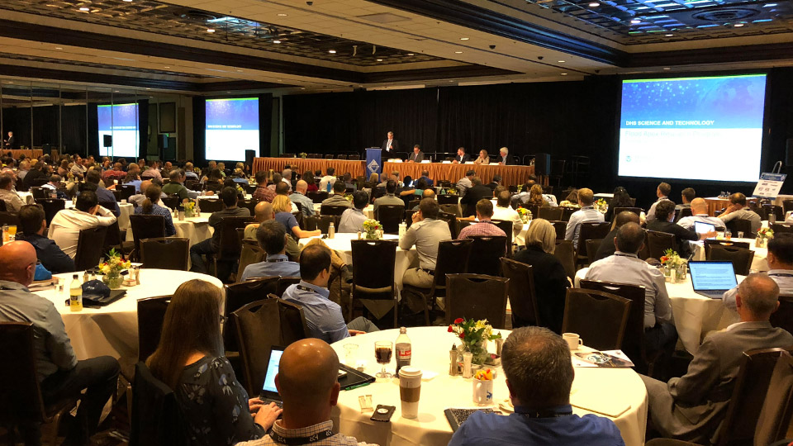
Larry A. Larson Speaker Series
4th Larry A. Larson Speaker Series
“Big Data = Big Future & Big Challenges,” September 2018, Reno, NV
Notes:
The 4th Annual Larry A. Larson Speakers Series was held in conjunction with the FMA Conference in Reno, Nevada on September 5th. The topic was “Big Data.” This event was a great success. There were over 400 people in attendance. The ASFPM Foundation is considering holding future LAL Speaker Series events at State Chapter Conferences.
The ASFPM Foundation held the 6th Gilbert F. White Forum on March 12-13, 2019 in Washington, DC. The topic of the forum was “Urban Flooding.” Over 100 people were in attendance.
The 5th Annual Larry A. Larson Speaker Series will be held on October 16, 2019 at the New Jersey Chapter Conference. The topic is “Increasing Our Resilence to Urban Flooding.”

Slide 11
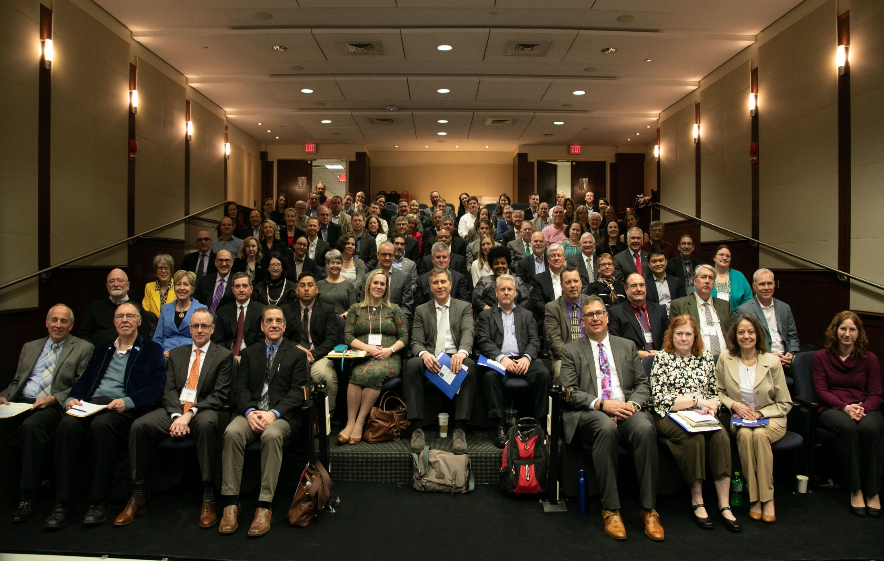
Gilbert White National Flood Policy Forum
4th Larry A. Larson Speaker Series
“Big Data = Big Future & Big Challenges,” September 2018, Reno, NV
Notes:
This event is by invitation only:
Siavash Beik
David Knipe
A Forum Report is being finalized as we speak. All Chapters will receive copies of the report.

Slide 12
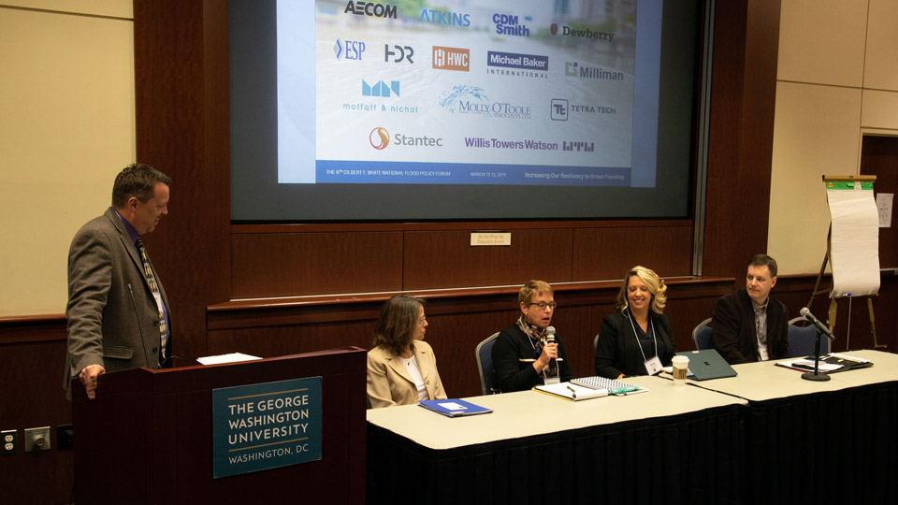
Gilbert White National Flood Policy Forum
4th Larry A. Larson Speaker Series
“Big Data = Big Future & Big Challenges,” September 2018, Reno, NV
Notes:
This event is by invitation only:
Siavash Beik
David Knipe
A Forum Report is being finalized as we speak. All Chapters will receive copies of the report.

Slide 13
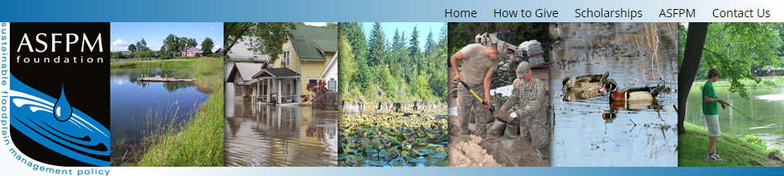
ASFPM Foundation Scholarships
Student Paper Competition
Future Leaders Scholarship
6th Assembly of the Gilbert White National Flood Policy Forum
“Increasing Our Resiliency to Urban Flooding,” March 2019, DC
Gilbert White National Flood Policy Forum Panel Discussion
“Increasing Our Resiliency to Urban Flooding,” March 2019, DC
4th Larry A. Larson Speaker Series
“Big Data = Big Future & Big Challenges,” September 2018, Reno, NV

Slide 14
ASFPM Foundation Scholarships
ASFPM Foundation Student Paper Competition
  Abstracts submitted in January
  Topic areas include planning, modeling, standards, natural functions, risk reduction
  Three semi-finalists are selected to submit paper
    1st Place - $1,000
    2nd Place - $500
    3rd Place - $250
6th Assembly of the Gilbert White National Flood Policy Forum
“Increasing Our Resiliency to Urban Flooding,” March 2019, DC
Gilbert White National Flood Policy Forum Panel Discussion
“Increasing Our Resiliency to Urban Flooding,” March 2019, DC
4th Larry A. Larson Speaker Series
“Big Data = Big Future & Big Challenges,” September 2018, Reno, NV

Slide 15
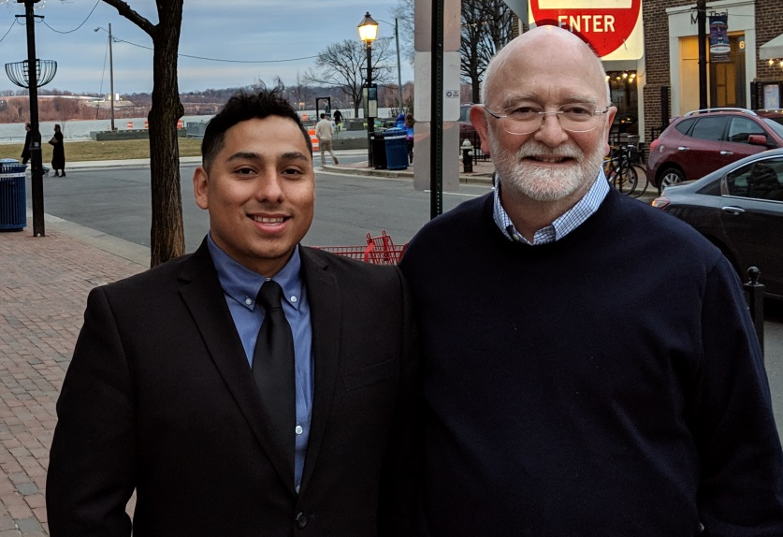
ASFPM Foundation Scholarships
Future Leaders Scholarship
  Started in 2018
  Awarded to a deserving college student who plans to work after graduation in a profession that directly or indirectly supports the field of flood risk management
  Up to $25,000 per year for two years for tuition and living expenses
  Mentoring and involvement
  Jesus Mulgado, Inaugural Future Leaders Scholar (2018-2020)
6th Assembly of the Gilbert White National Flood Policy Forum
“Increasing Our Resiliency to Urban Flooding,” March 2019, DC
Gilbert White National Flood Policy Forum Panel Discussion
“Increasing Our Resiliency to Urban Flooding,” March 2019, DC
4th Larry A. Larson Speaker Series
“Big Data = Big Future & Big Challenges,” September 2018, Reno, NV
Notes:
The first Future Leader Scholarship was awarded at the ASFPM Conference in Phoenix in June 2018
The ASFPM Foundation would like to award this scholarship annually, if financially feasible
A donor gave $20,000 to the Foundation to help start this scholarship

Slide 16
ASFPM Foundation Scholarships
Future Leaders Scholarship
  Next offered in 2020-2022 academic years
  Applications available in fall 2019
  ASFPM Foundation Board considering ability to offer the 2-year scholarship every year
  Please help the Foundation find deserving college undergraduates entering their junior year in 2020
6th Assembly of the Gilbert White National Flood Policy Forum
“Increasing Our Resiliency to Urban Flooding,” March 2019, DC
Gilbert White National Flood Policy Forum Panel Discussion
“Increasing Our Resiliency to Urban Flooding,” March 2019, DC
4th Larry A. Larson Speaker Series
“Big Data = Big Future & Big Challenges,” September 2018, Reno, NV
Notes:
Share information with schools, communities (committees), volunteer organizations….
Foundation is looking for contacts at colleges & universities to send scholarship information

Slide 17

Visit our Website…
…and encourage others
www.asfpmfoundation.org
…for ASFPM Foundation scholarship information

Slide 18
Projects Committee
Best Practices and Case Studies Compendium
NAI Updates
Flood Mapping for the Nation
Association of Wetland Managers Workshop
Rocky Mountain Environmental Challenge
4 Forums
11 Symposia
LAL Speaker’s Series
Auctions
Notes:
These are past projects funded by the ASFPM Foundation. The Foundation does not actually do the projects, it funds the projects.
The ASFPM Foundation funds projects that can be used by ASFPM members and Chapter members.
These projects can be found on the ASFPM Flood Science Center website.
ASFPM Foundation projects funded for the upcoming year:
Association of Wetland Managers Workshop
Rocky Mountain Environmental Challenge
Elevation Certificate Reference Guide developed by Georgia ASFPM’s State Chapter.
5. The ASFPM Foundation is always looking for potential projects.

Slide 19
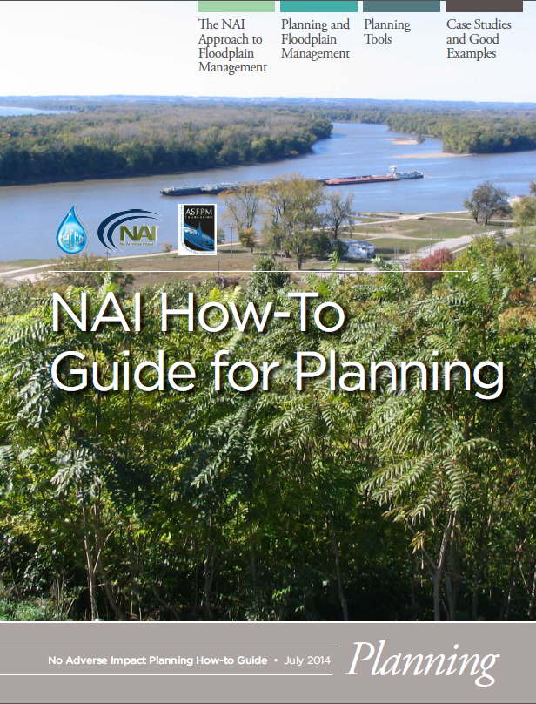
NAI How-To Guides
Features:
  5 NAI level tools in each guide
  Case studies and “How-To” information
  Based on 7 building blocks in NAI Toolkit. All guides complete: Mitigation, Infrastructure, Planning, Education / Outreach, Regulations, Emergency Services, and Mapping
Notes:
So what are working on now? In 2012 an effort began to create a series of NAI How-To Guides. When completed, they will cover the seven building blocks or areas of community work profiled in the NAI Toolkit: Hazard identification, infrastructure, mitigation, emergency services, regulations, planning, and education/outreach. Each how-to guide identifies at least five NAI level tools that can be adopted or used by communities. Seven of them are now published, the sixth is about to be published and we have the seventh as a draft.

Slide 20
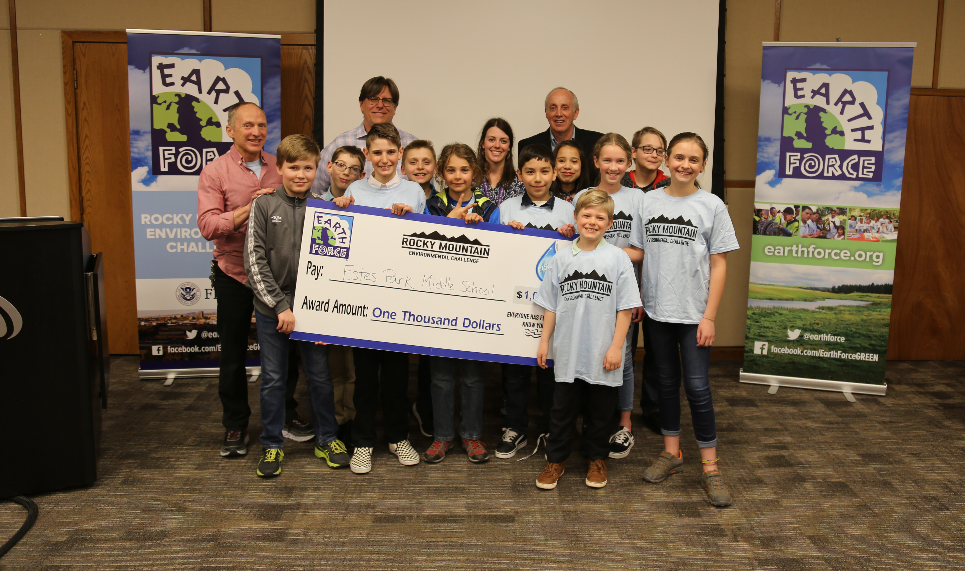
Steve Johnson’s 6th Grade Science Class
Owen Brandewie
Farrah Collins
Cash Faith
Mackenzie Francis
Gregory Hardy
Christian Harrison
Jeffrey Hinton
Clare O'Brien
Emma Rountree
Elisha Scarborough
Joshua Schultz
Ryan Schwartz
Angel Venzor Quiroz
Matthew Voelz
Notes:
Rocky Mountain Environment Challenge Project
Partnered with FEMA Region 8 and Earth Force (Non-Profit)
Five schools-Larimar County, Colorado
Presented Action Projects focused on flooding and other natural hazard issues affecting their communities
Presented innovative project solutions
Tough issues, such as campus flooding, stormwater management, school emergency preparedness, impacts of flooding on wildlife and community wildfire prevention.
Project was started because of a gap between the level of engagement needed to prepare communities for flooding and public participation.
Young people an avenue to improve disaster preparedness
Over last two years we saw students redesign their schoolyards to increase filtration, remove impervious surface to allow for drainage, create disaster preparedness kits, and promote fire safety to control flooding.
Saw students increase community awareness. For example, Owen and his friends spent a Saturday presenting their findings as a local community fair.
While the projects and the outreach are important (and perhaps the most direct element of the program) – the long-term impact on the young people is even more valuable to long-term flood management. Resulted in three changes in young people:
85% increased their awareness of the threats facing their communities
79% increased their commitment to improving their communities
83% increased their belief that they can make a difference
Awareness, commitment, belief. These are the building blocks of an engaged involved citizenry. The kind of community members wer need to improve disaster resilience.

Slide 21

Estes Park Middle School
“I learned that some houses could be flammable because of the trees and bushes around the house. I also had fun doing this because I was with friends. I was also nervous because I had to present to judges and people and I’m scared talking to audience. Thank you for letting me do this with you guys.” - Angel Quiroz
“Working on the Earth Force Project has made me see different perspectives on different topics. The Earth Force Project also taught me astounding facts on hazardous wildfires and how to be protected against them. I hope that this project will help lots of mountain side communities not only Estes Park.” - Karla Rojas

Slide 22
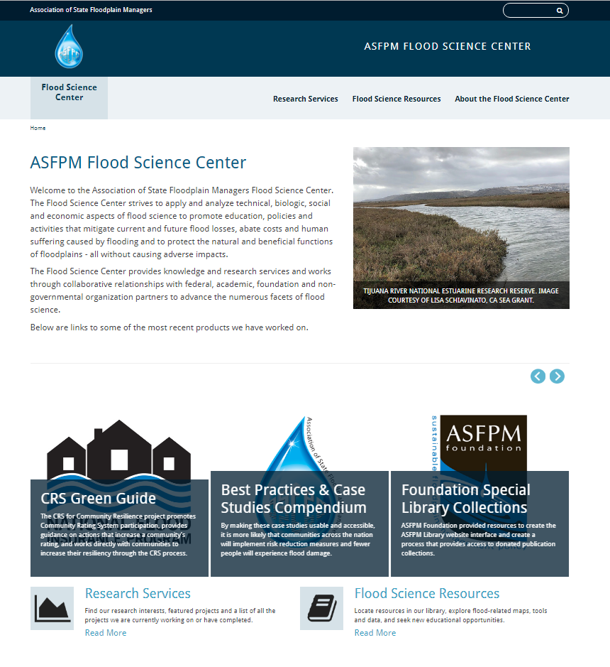
Flood Science Center Webpage
Features:
  Listing of new, ongoing, and completed projects
  Able to download completed reports, use online guides (i.e., CRS Green Guide)
  Includes library portal with curated special collections
    Compendium of case studies
    Floodplain Managers Notebook
  Great resource for practicing floodplain managers
www.floodsciencecenter.org

Slide 23
THANK YOU

Slide 24
ASFPM Update

Slide 25
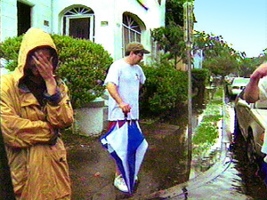
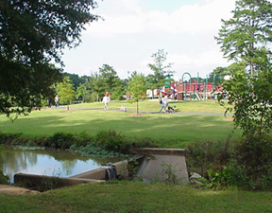


ASFPM’S MISSION
To promote education, policies and activities…
that mitigate the losses, costs and human suffering caused by flooding,…
and protect the natural and beneficial functions of floodplains…
– all without causing adverse impacts.
Notes:
As you know, ASFPM is a national non-profit, professional, organization. What you might not know is that ASFPM is a mission driven membership organization. The mission is quite simple – reduce misery caused by floods and protect natural floodplains wherever possible.

Slide 26
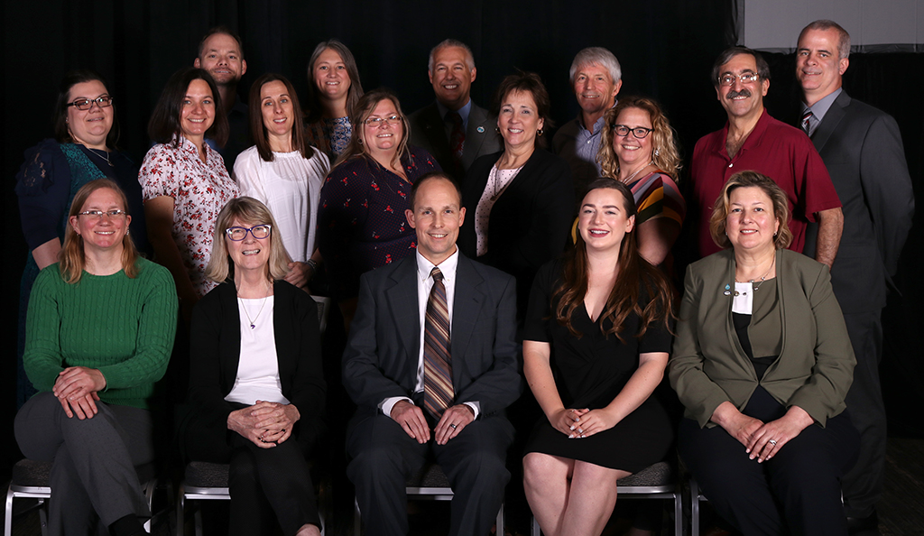
ASFPM Board of Directors
Region 5 Director Chapter Director District 2
Steve Ferryman Katie Sommers-WI
Notes:
ASFPM is a respected national voice in on flooding issues. ASFPM continually provides input to Congress and the Administration. Did you know that ASFPM was the first to promote hazard mitigation? We had a hand legislatively in the formation of the Hazard Mitigation Grant Program in the Stafford Act to the FMA program and even Increased Cost of Compliance – all of these were ASFPM ideas in the beginning. ASFPM continues to be an advocate for improved flood mapping – in fact that is how ASFPM was founded by a group of Midwestern states that were having issues with flood maps. We are also an advocating to continue Map Maintenance (unmet needs)
The ASFPM’s certification of floodplain managers through the CFM program has been on of our biggest successes. We now are above 10,500 CFMs in the nation as of 5/1/2019.
Of course ASFPM’s annual conference is the nation’s largest event dealing with all things flood. The 2019 annual conference in Cleveland had over 1,000 attendees with lots of training sessions and field tours.
The 2020 ASFPM Conference will be held in Fort Worth, Texas June 7-11, 2020. Call for Abstracts will be starting September 2019.
Finally ASFPM’s Flood Science Center section undertakes projects that involve research, development of tools and publications for practitioners, and develops unique datasets collected by ASFPM.
So lets look at a few of these items in more detail.

Slide 27
ASFPM COMMITTEES
Flood Insurance
Flood Mitigation
Floodplain Regulations
Nonstructural Floodproofing
International
Professional Development & Continuing Education
Risk Communication & Outreach
Higher Education
Arid Regions
Coastal Issues
Mapping & Engineering Standards
Natural & Beneficial Functions
No Adverse Impact
Stormwater Management
Notes:
ASFPM is a respected national voice in on flooding issues. ASFPM continually provides input to Congress and the Administration. Did you know that ASFPM was the first to promote hazard mitigation? We had a hand legislatively in the formation of the Hazard Mitigation Grant Program in the Stafford Act to the FMA program and even Increased Cost of Compliance – all of these were ASFPM ideas in the beginning. ASFPM continues to be an advocate for improved flood mapping – in fact that is how ASFPM was founded by a group of Midwestern states that were having issues with flood maps. We are also an advocating to continue Map Maintenance (unmet needs)
Interested in getting more involved in one of the ASFPM’s Committees? You should check out ASFPM’s website and committee work plans, then contact committee co-chairs.

Slide 28
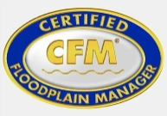
What does ASFPM do?
National and State Policy Issues
National CFM® Certification
State Chapter Services & Support
Develop Tools, Publications, & Resources for State and Local Floodplain Managers
No Adverse Impact (NAI)
Conferences & Events
Training (ASFPM Webinar Series)
Research
National Flood Barrier Testing & Certification Program
Notes:
ASFPM is a respected national voice in on flooding issues. ASFPM continually provides input to Congress and the Administration. Did you know that ASFPM was the first to promote hazard mitigation? We had a hand legislatively in the formation of the Hazard Mitigation Grant Program in the Stafford Act to the FMA program and even Increased Cost of Compliance – all of these were ASFPM ideas in the beginning. ASFPM continues to be an advocate for improved flood mapping – in fact that is how ASFPM was founded by a group of Midwestern states that were having issues with flood maps. We are also an advocating to continue Map Maintenance (unmet needs)
In 2019, ASFPM hosted a record number of webinars – we offer both low-cost and free webinars. In fact, over 4,000 individuals took advantage of our free webinars. Also, a new member benefit in 2019 is our monthly national policy briefing. Held monthly, this short half hour briefing gets folks up to speed on the current happenings in the national policy arena.
ASFPM’s Flood Science Center section undertakes projects that involve research, development of tools and publications for practitioners, and develop unique datasets.
Finally, ASFPM works to create programs where there is a gap. This is how our National Flood Barrier Testing and Certification Program was born. ASFPM’s corporate partners who manufactured flood protection equipment identified the need for strong standards to ensure that high quality products were in the marketplace that would actually work as advertised. And, in 2014, after about 15 years of work and research, the National Flood Barrier Testing & Certification Program was launched.

Slide 29

Policy Issues
The broad problem of flood-loss reduction is that the rate at which flood losses are being eliminated by construction of engineering or land-treatment works is of about the same magnitude as the rate at which new property is being subjected to damage. - GFW
Notes:
ASFPM dedicates a significant amount of resources to follow and input into national policy issues that affect floodplain managers. Our national policy team includes staff in the ASFPM Executive Office and in Washington DC. Policy decisions made in Washington DC have a profound effect on our communities and we must ensure that from a floodplain management perspective we are constantly pushing in the direction of effective floodplain management policies.
[GFW is Gilbert Fowler White]

Slide 30

Federal Budget (FY20)
Program | Administration | House | Senate
FEMA -Flood Mapping | $100 m | $263 | $?
FEMA – Pre Disaster Mitigation (PDM) | $0 m | $0 | $0
FEMA – Flood Mitigation Assistance (FMA) | $175 m | $175 | $?
Record mapping funding from House!
PDM changes to formula program in FY20
We will see lots of action in September. A Continuing Resolution likely.
Notes:
The House has passed 10 of the 12 regular appropriations bills for Fiscal Year 2020. The Senate, however, has not even marked up any of its bills in committee. Senate leadership did not want to begin mark-ups until an agreement on overall budget amounts was reached. After lengthy negotiations between the Congress and the White House, an agreement was finally reached and was passed in the House on July 25th, just before the House began its August recess. It is widely expected that the Senate, which is in session for another week, will pass it
before leaving for its August recess. That means that September will see many appropriations mark-ups in the Senate Appropriations Committee and perhaps some bills passed. However, since both the House and Senate do not return until September 9th, that only leaves 3 weeks until the new fiscal year begins. It seems very unlikely that all of the bills can be marked-up, reported out of committee, passed and agreements reached between Senate and House versions in 3 weeks. A Continuing Resolution to keep federal agencies operating at FY 2019 levels is almost inevitable

Slide 31
NFIP Reauthorization
NFIP expires 09/30/19.
House bill HR 3167 and HR 3111 passed out of committee
  Comprehensive bill, ASFPM supports
Senate bill S 2187 introduced in July, similar to SAFE Act that was introduced last Congress
  Comprehensive bill, ASFPM supports elements of the bill
Similarities:
  Positive changes to ICC (increase to 60K and allow payments in addition to claim amount)
  State revolving loan fund for mitigation
  Assistance to lower income property owners
  Caps annual increases on flood insurance premiums
  Begins to address urban flooding issue
Notes:
On December 21, 2018 Congress approved a short term extension of the NFIP until May 31, 2019. Since it is a new Congress new NFIP reform bills will need to be introduced in the House and Senate. The 2017 bill the house passed would die and they would have to try again. In the Senate, since no bill has actually passed, it would be likely the that the three bills in play would be re-introduced as they are all bipartisan and comprehensive. The House bill was way too partisan to gain traction in the Senate.
ASFPM has been very involved over the past two years on NFIP reform and reauthorization, testifying in front of Congress, working with other national organizations, and working with FEMA on reform ideas. ASFPM has established the following principles for reauthorization of the NFIP in 2017:
Reauthorize, fund and enhance the National Flood Mapping Program (NFMP). Authorized by the 2012 reform act at $400 million annually, the NFMP is still desperately needed to map approximately 3 million miles of unidentified flood hazard areas, identify dam failure zones and maintain the existing inventory of 1.2 million miles of flood studies.
Forgive the NFIP debt (currently at about $20.5 billion). The NFIP, as designed by Congress, was never intended to fully repay claims from catastrophic events. Full repayment of interest and principal – especially as interest rates rise - undermines the financial stability of the NFIP and will be impossible to accomplish.
Ensure a system where a strong NFIP co-exists with private sector flood policies. Require private flood providers to share in costs to maintain flood mapping and floodplain management efforts. Ensure changes to facilitate private flood policies do not harm other elements of the NFIP: mapping, mitigation, and floodplain management.
Address NFIP affordability issues that will re-emerge in the next 3-5 years. While ASFPM supports the continuation of the current glide path towards actuarial rates to facilitate accurate risk messaging and promote mitigation, flood insurance affordability was largely ignored in previous two reform bills and must be addressed now. Affordability subsidies should support mitigation, rather than subsidize insurance premiums only.
Support and strengthen the mitigation elements of the NFIP, especially Increased Cost of Compliance.
Strengthen compliance with mandatory insurance provisions of the NFIP. Two areas are particularly problematic – owners maintaining flood insurance policies as a condition of loans after the first few years and owners maintaining policies after receiving disaster assistance and/or after the 3-year group flood insurance policy expires.
The ASFPM Priorities document has more specific legislative proposals. These ideas came from ASFPM leadership as well as the grassroots effort that likely some of you participated in when we developed our 2015 National Flood Policies and Programs in Review!

Slide 32
NFIP Reauthorization
Differences
  House bill doesn’t address debt; Senate bill would use interest payments for mitigation
  House bill authorizes $500 million for flood mapping; Senate bill remains at $400 million
  House bill has authorization for CAP-SSSE program and doubles its funding from current levels; Senate bill doesn’t have this
  House bill has provisions for dealing with agricultural buildings from both a floodplain management and insurance standpoint
ASFPM developed/updated Principles and Priorities documents for reform.
Notes:
On December 21, 2018 Congress approved a short term extension of the NFIP until May 31, 2019. Since it is a new Congress new NFIP reform bills will need to be introduced in the House and Senate. The 2017 bill the house passed would die and they would have to try again. In the Senate, since no bill has actually passed, it would be likely the that the three bills in play would be re-introduced as they are all bipartisan and comprehensive. The House bill was way too partisan to gain traction in the Senate.
ASFPM has been very involved over the past two years on NFIP reform and reauthorization, testifying in front of Congress, working with other national organizations, and working with FEMA on reform ideas. ASFPM has established the following principles for reauthorization of the NFIP in 2017:
Reauthorize, fund and enhance the National Flood Mapping Program (NFMP). Authorized by the 2012 reform act at $400 million annually, the NFMP is still desperately needed to map approximately 3 million miles of unidentified flood hazard areas, identify dam failure zones and maintain the existing inventory of 1.2 million miles of flood studies.
Forgive the NFIP debt (currently at about $20.5 billion). The NFIP, as designed by Congress, was never intended to fully repay claims from catastrophic events. Full repayment of interest and principal – especially as interest rates rise - undermines the financial stability of the NFIP and will be impossible to accomplish.
Ensure a system where a strong NFIP co-exists with private sector flood policies. Require private flood providers to share in costs to maintain flood mapping and floodplain management efforts. Ensure changes to facilitate private flood policies do not harm other elements of the NFIP: mapping, mitigation, and floodplain management.
Address NFIP affordability issues that will re-emerge in the next 3-5 years. While ASFPM supports the continuation of the current glide path towards actuarial rates to facilitate accurate risk messaging and promote mitigation, flood insurance affordability was largely ignored in previous two reform bills and must be addressed now. Affordability subsidies should support mitigation, rather than subsidize insurance premiums only.
Support and strengthen the mitigation elements of the NFIP, especially Increased Cost of Compliance.
Strengthen compliance with mandatory insurance provisions of the NFIP. Two areas are particularly problematic – owners maintaining flood insurance policies as a condition of loans after the first few years and owners maintaining policies after receiving disaster assistance and/or after the 3-year group flood insurance policy expires.
The ASFPM Priorities document has more specific legislative proposals. These ideas came from ASFPM leadership as well as the grassroots effort that likely some of you participated in when we developed our 2015 National Flood Policies and Programs in Review!

Slide 33
Disaster Reform and Recovery Act (DRRA)
Signed into law in October 5, 2018 it has several sections positively impacting floodplain management and hazard mitigation:
  Sec 1206 allows for reimbursement through Public Assistance of mutual aid assistance for substantial damage and building inspections post-disaster (this is language ASFPM wanted in law)
  Increases allowable grantee and subgrantee management costs under HMGP and PA; this will help build capability
  Authorizes the availability of HMGP for fire management (FMAG) disaster declarations and identifies several specific types of eligible mitigation activities that impact flood risk management
  Authorizes hazard mitigation assistance as part of Economic Development Administration economic adjustment grants
  Deems that a disaster loan is not a duplication of benefits
Notes:
The DRRA is probably one of the most significant reforms of the Federal Stafford Act, especially from a hazard mitigation and floodplain management perspective since the Disaster Mitigation Act of 2000. While there have been other reforms since 2000, most have focused on response and recovery. It is fair to say that a primary focus of the DRRA is on hazard mitigation and that could have a significant impact on the day-to-day work of floodplain managers and hazard mitigation professionals.
So what is in the DRRA? What is good about it?
Perhaps the most important provision to ASFPM was a change in law aimed at specifically repealing an almost 20-year old policy by FEMA that specifically disallows the reimbursement of activities like most building inspections and substantial damage determinations through the Public Assistance Program. Why this is so important is that when an activity is eligible for reimbursement, communities and states are much more likely to request mutual aid assistance through mechanisms like EMAC. Now with this change in law, communities can request help through EMAC to do substantial damage determinations and tap into floodplain managers from throughout the country that are willing to help.
For those dealing with mitigation grants, the increase in management costs is a big deal; often state mitigation programs are mostly supported through these management costs.
For western states and Florida – there is now a permanent authority to trigger HMGP whenever a Fire Management declaration is issued. So just like for major disasters, HMGP will be available after FMAG declarations and there are several specific types of mitigation actions identified that actually reduce flood risk.
Another provision would authorize the Department of Commerce Economic Development Administration to make hazard mitigation assistance eligible under economic adjustment grants. This is a new pathway for hazard mitigation assistance that could be useful.

Slide 34
Disaster Reform and Recovery Act (DRRA)
Big changes for the Pre-Disaster Mitigation Program which will be called BRIC:
  Authorizes new technical/financial assistance category for establishing, implementing, and enforcing latest building codes
  Gives FEMA authority to withdraw PDM assistance and provide it to other states through a competitive program if awarded funds are not obligated in 3 years from initial obligation.
  Adds two new criteria for PDM award selection/assistance which are to what extent has the applicant adopted and enforced the latest building codes and to what extent will the project increase the level of the community’s resiliency
  Changes the funding for PDM to a formula based on 6% of estimated disaster costs.
Notes:
But the biggest mitigation changes in the DRRA are to the pre-disaster mitigation grant program. There are four major changes.
PDM will now be able to be used to establish/implement/enforce the latest building codes. According to a blog by the CEO of the International Code Council: 16% of the population lives in communities with codes that are at least 9 years old and at least 2 million people live in communities with codes that are at least 15 years old. Eight states with statewide code requirements are on building codes that are 9 or more years old. These states cover nearly a quarter of the U.S. population. Lack of resources is the primary reason communities do not update their codes to more recent editions or enforce the codes they have in place.
FEMA would have new authorities to redistribute unused PDM funds after three years of obligation and now, for the first time, a criteria for selecting/awarding PDM assistance is to what extent the applicant has adopted and enforced the latest building codes.
Finally and this is huge. PDM will now be based on a formula versus having to have an appropriated amount by Congress. In nearly 20 years since the creation of PDM, funding has swung wildly. Recently, for three years in a row, the Administration actually proposed to zero out PDM. It has been funded as high as $250 million (last year). Now it will be 6% of certain disaster expenditures from the previous year. What does that mean in reality.

Slide 35
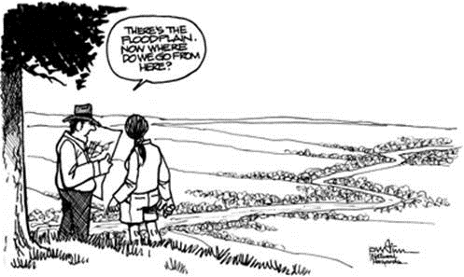
Non-Traditional Resources for Flood Risk Reduction
Notes:
As floodplain managers, we know that we need data, techniques, and tools to do our jobs effectively. Here is a question. Lets say that the NFIP didn’t exist. No flood insurance, no NFIP regulations. How might you manage flood risk? In your community? For you personally? How would you advise your friends. I want you to ponder that as I discuss some of what I am calling non-traditional resources for flood risk reduction.
One of the focus areas of ASFPM is applied research and tool development. Many of these are done irrespective of the NFIP. Whether it is working with partners or other agencies to fill a need that exists or take a program in a new direction, or That is why ASFPM and the Science Services section of ASFPM exist – to make your lives easier and to enable the floodplain management practitioners to be successful. For the remainder of the presentation, I want to highlight some of the projects and research that ASFPM is doing so that you might be able to do your job more effectively!

Slide 36
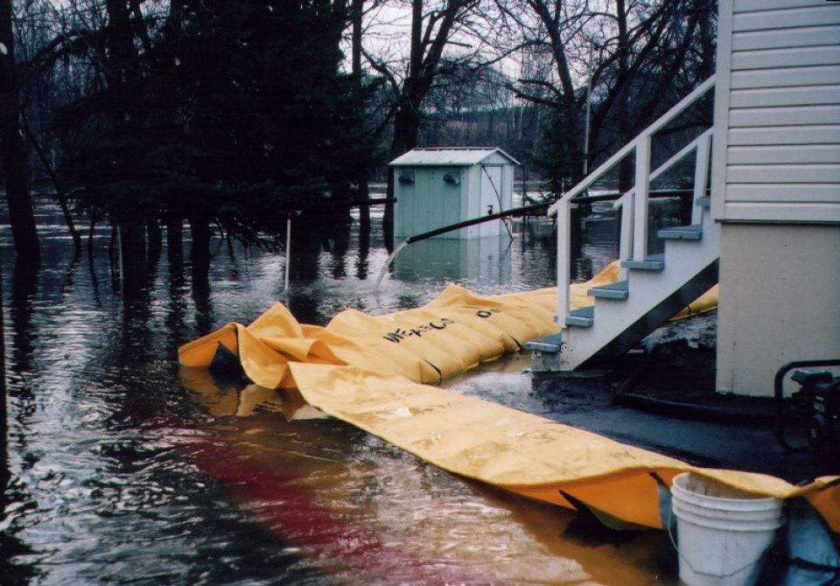
NFBTCP
National Flood Barrier Testing and Certification Program
Challenge: High demand for reliable flood mitigation solutions
Opportunity: Manufacturers have the means to obtain third-party certification with the National Flood Barrier Testing & Certification Program
Benefit: Product differentiation by proving it meets consensus standard and the national program’s rigorous protocol
Temporary (Perimeter) Barrier, Certified Silver Level
Notes:
36

Slide 37
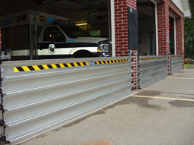
NFBTCP
National Flood Barrier Testing and Certification Program
Currently tests/certifies:
    Perimeter barriers
    Opening barriers
    Backwater valves
    Mitigation (flood abatement) pumps
    Sealants
Closure Device (Opening Barrier), Certified Platinum Level
Notes:
37

Slide 38
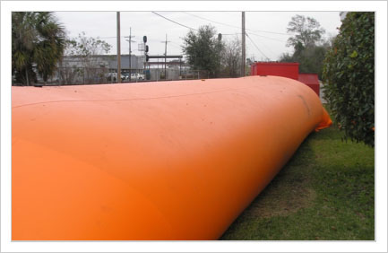
NFBTCP
National Flood Barrier Testing and Certification Program
  Certification requires water based testing, component/material testing and manufacturing facility audits
  Tests to ANSI/FM Approvals 2510 Standard
Temporary Barrier (Opening Barrier), Certified Platinum Level
Notes:
38

Slide 39
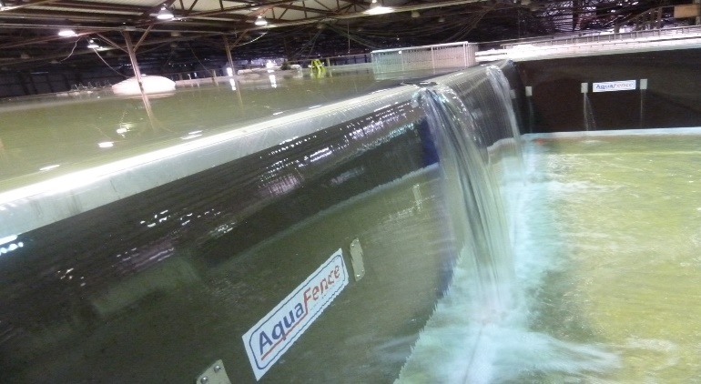
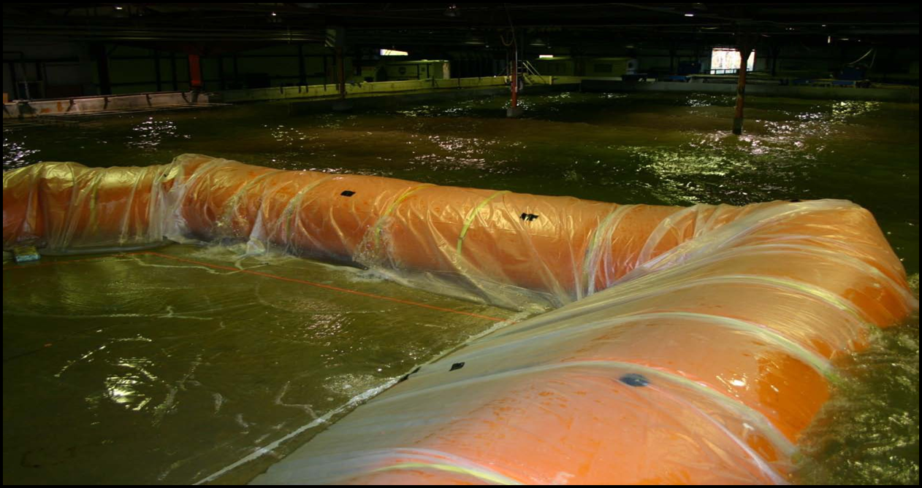
NFBTCP
Partnership
ASFPM (Program administrator, maintains website)
FM Approvals (Certifies the product, confers the FM Diamond, conducts materials/component testing, performs manufacturing facility audits)
US Army Corps of Engineers (Conducts water testing at ERDC lab in Vicksburg Mississippi)
Overtopping test at ERDC. Water is brought to 1 inch above the barrier and allowed to overflow.
1 foot wave test at ERDC
Notes:
39

Slide 40

NFBTCP
Certified products earn the FM Diamond, a globally recognized quality mark from FM Approvals
The FM Diamond is like the Underwriters Laboratory certification for consumer electronics
FM Diamond ensures product quality and consistency
Notes:
40

Slide 41

No Adverse Impact (NAI)
Even if we perfectly implement the current standards, damages will increase because we are putting development in the path of disaster.
No Adverse Impact (NAI) is an approach that ensures that the action of any community or property owner, public or private, does not adversely impact the property and rights of others.
Notes:
We have done a lot of things right, to include the National Flood Insurance Program – there was nothing before that. But damages will still increase because we are putting folks in harm’s way. That is why ASFPM created the No Adverse Impact Initiative in the early 2000’s to create a framework for effective flood risk management.
NAI is ASFPM’s own homegrown “resiliency” effort. NAI is a philosophy for managing floodplains where the main principle is “do no harm” to neighboring properties or to the environment. So that means a development should not increase flood heights, nor increase flood velocities, nor damage the floodplain environment. It isn’t a No Development initiative; rather, it tries to ensure that whatever development occurs in a watershed has impacts identified and mitigated. And, it has a rock solid legal foundation. In fact, in 2015, the philosophy of NAI was upheld in two state supreme courts in Texas and South Carolina. In the case of Texas it found that a community could be liable for permitting adverse impacts and in the case of South Carolina higher floodway standards were viewed favorably as reducing adverse impacts.

Slide 42
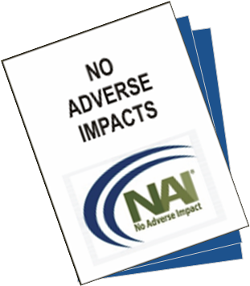
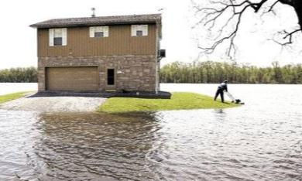
Benefits of the NAI Approach
Will reduce future flood damages
Will reduce future suffering
Will protect the communities natural resources and amenities
Will improve the quality of life
Will provide for more sustainable growth within the community
Will reduce the community’s liability
Notes:
Many municipal attorneys are not experts in community liability or takings
The research provides tot first national update since 1988
The importance of how locals can effectively deal with these legal issues cannot be overstated

Slide 43
NAI How-To Guides
Features:
  5 NAI level tools in each guide
  Case studies and “How-To” information
  Based on 7 building blocks in NAI Toolkit:
    Mitigation
    Infrastructure
    Planning
    Education / Outreach
    Regulations
    Emergency Services
    Mapping
Notes:
In 2012 an effort began to create a series of NAI How-To Guides. This past spring we completed the final guide on Emergency Services. The How To Guides cover the seven building blocks or areas of community work profiled in the NAI Toolkit: Hazard identification, infrastructure, mitigation, emergency services, regulations, planning, and education/outreach. Each how-to guide identifies at least five NAI level tools that can be adopted or used by communities. Five of them are now published, the sixth is about to be published and we have the seventh as a draft.

Slide 44

In the Works!
Capital Improvement Planning for future flood conditions (partnership with APA )
Update of Elected Officials Guide to Addressing Community Flood Problems
Post-flood compliance and building local (community) capacity
Historic flood documentation
Research in to effectiveness of floodways
Notes:
Here are just a few of the projects ASFPM has in the works.
Capital Improvement Planning for future conditions will result in a Planners Advisory Service report that should be out in the winter of 2020.
The updated elected officials guide will be done in a multi-media format that includes watchable interviews with elected officials, it is due out in late fall of 2019.
The post-flood compliance and building local community capacity is an exciting new initiative of ASFPM’s as a direct result of the legislative change from last October’s DRRA. An initial white paper on the effort with a conceptual plan will be coming out later this fall.
The Cooperating Technical Partners Information Exchange webinar series will be hosting a free webinar on the findings of our research into the effectiveness of floodways on September 19th where the topic focusing on the original intent of the floodway will be featured.

Slide 45
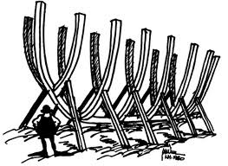
Thank You
The present status of floodplain management does not encourage complacency ... On balance, progress has been far short of what is desirable or possible, or what was envisaged at times when the current policies and activities were initiated - GFW
Be a member, get involved!
Credit given to the Natural Hazards Observer and Rob Pudim for all illustrations in this presentation
www.floods.org
Notes:
Well those are just the highlights of the many, many things ASFPM is involved with right now. Remember, ASFPM is your professional organization! So in closing, I sincerely hope that you are a member of ASFPM’s [STATE NAME] Chapter and if not, please get involved. State chapters are critical, especially in focusing on state legislation and issues.
Remember too, that ASFPM is a direct membership association so if you are not a member of ASFPM, I invite you to join! For those of that are, thank you for your membership and I hope that you feel that we provide you a good return on your investment in us. The entire staff in Madison, Wisconsin and our dozens of volunteer leaders work very hard to earn your membership dollar!
Thank you.

