Slide 1

Collaborative Watershed Improvements
(Symons and Krause Drain Case Study)
A look into how a collaborative watershed improvement was performed with efforts from USDA (federal), OCRA (state), Hamilton (county), and Sheridan (town).
Joe
Kenton Ward, CFM
Joseph Miller, P.E.

Slide 2
Information Covered Today
Joe
History of Watershed.
What triggered the plan and projects?
What was the main focus of the original study?
What was the original plan?
How has the plan been implemented?
How was participation from so many parties managed?
Lessons learned

Slide 3
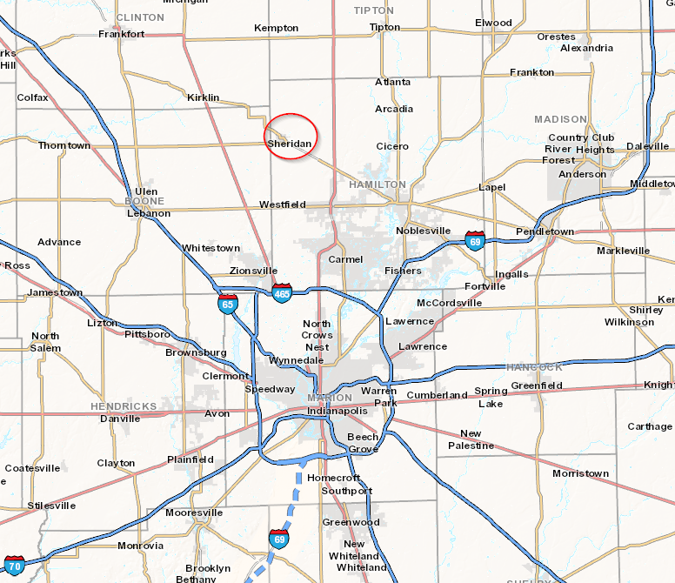
Location
Joe

Slide 4
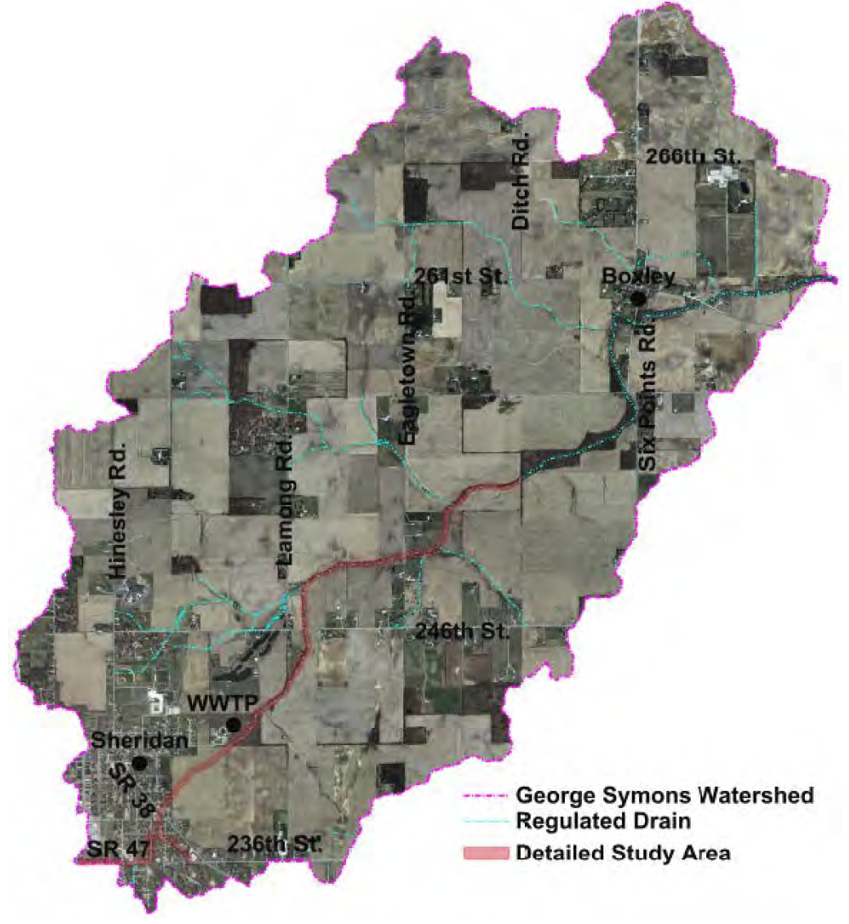
Watershed
Joe

Slide 5
History of Watershed
Joe
Town of Sheridan started as early as 1860+/-
Court Drain petitioned in 1877
  West Cicero Ditch
New Court Drain 1892
  Symons Open Drain
Portion of Drain Tiled 1919
  William Krause Drain
No detailed hydraulic modelling completed
  (FEMA Approximated Zone A)

Slide 6
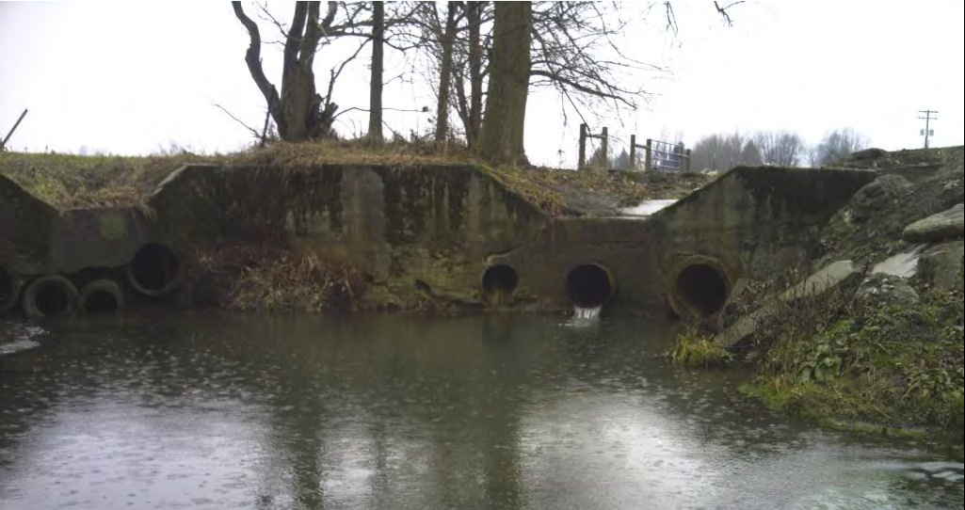
Houston We Have a Problem
Joe

Slide 7
What Triggered this Project?
Joe
June 2011
  Town of Sheridan received 6” of rain in 3-hours
  Several dozen structures flooded
  Areas all throughout town and downstream of town
  Residents within the watershed petitioned Hamilton County Drainage Board for assistance

Slide 8
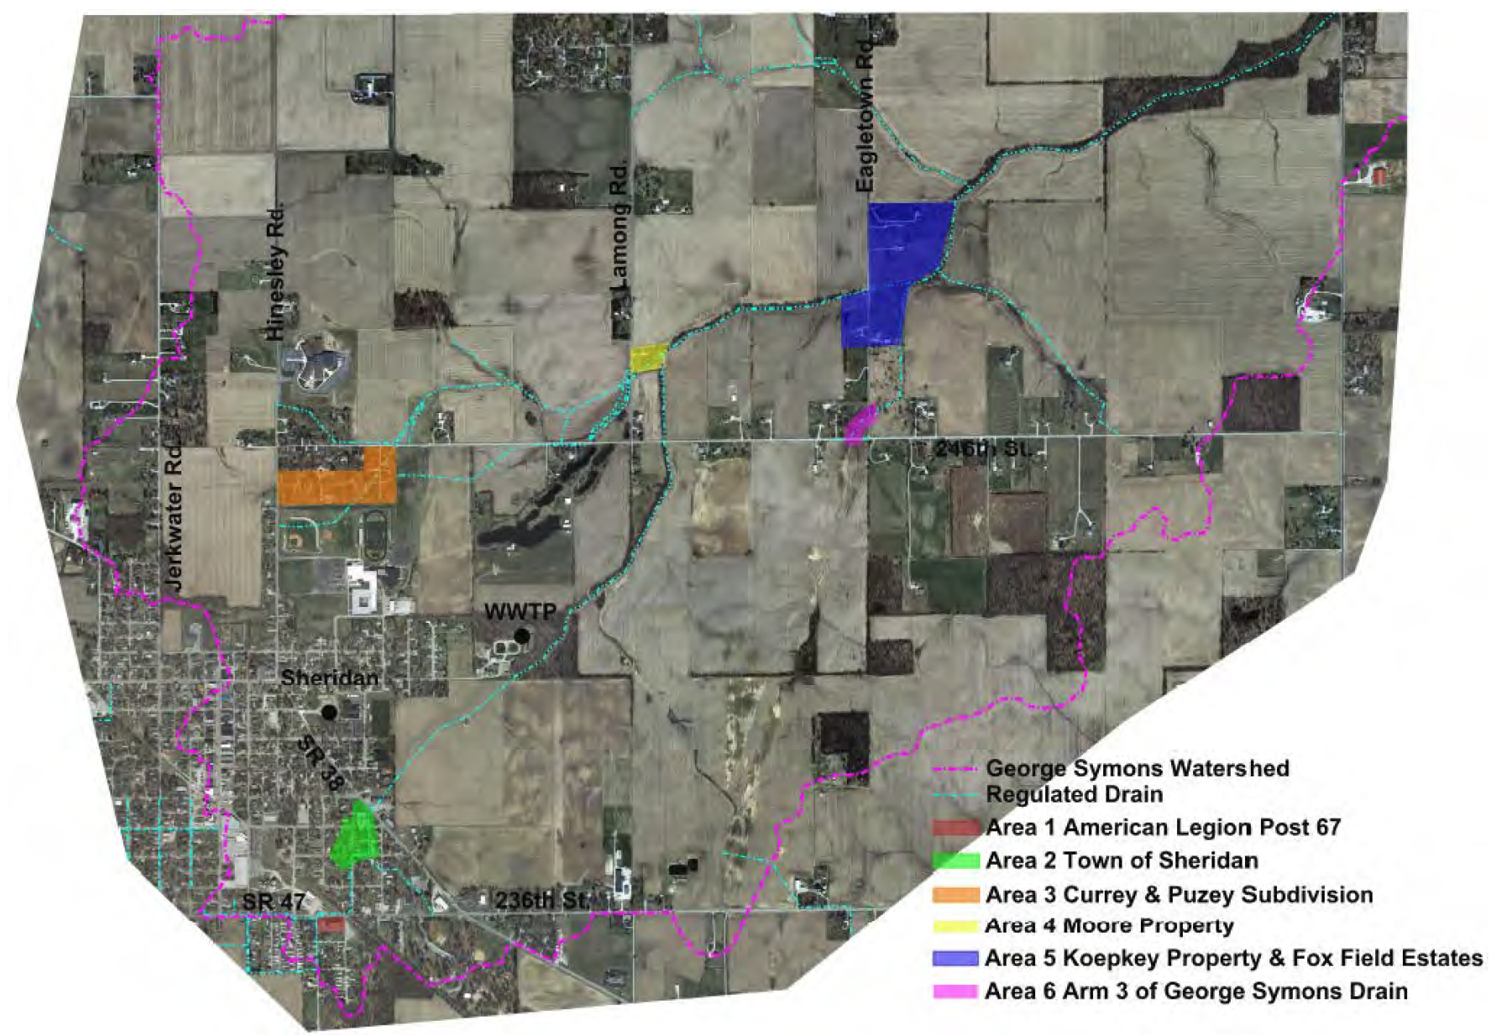
Areas that Flooded
Joe

Slide 9
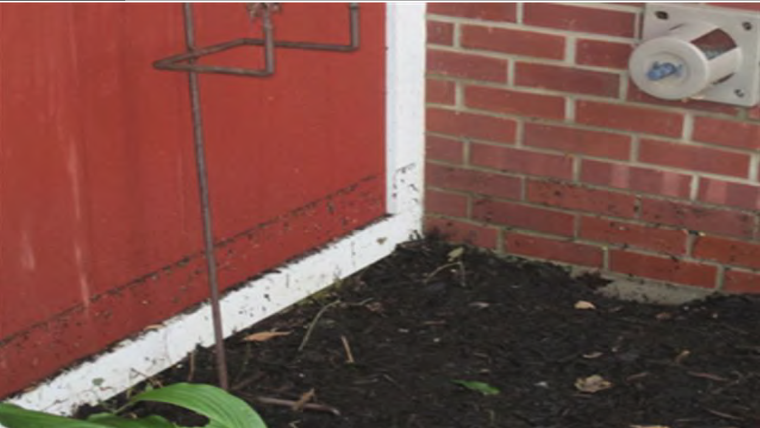
Areas that Flooded
Joe

Slide 10
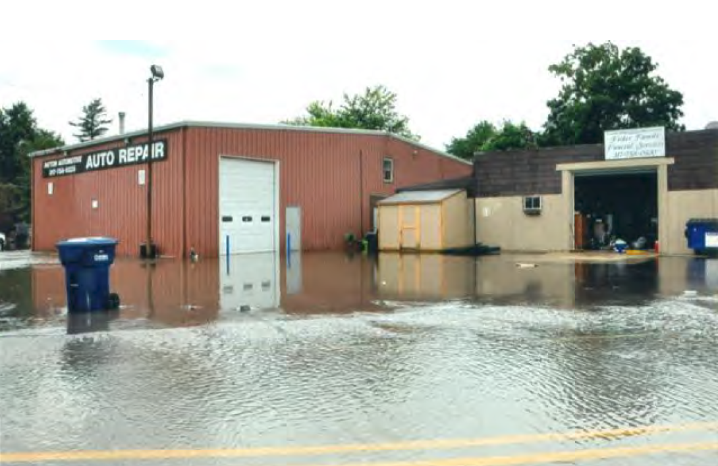
Areas that Flooded
Joe

Slide 11
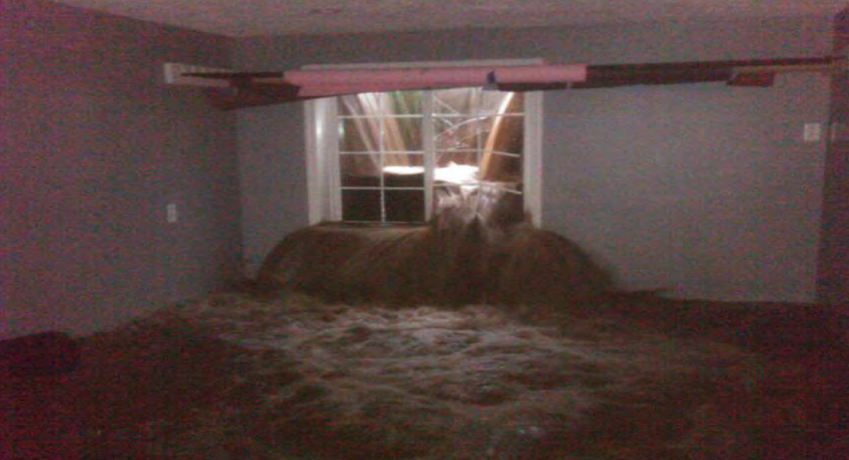
Areas that Flooded
Joe

Slide 12
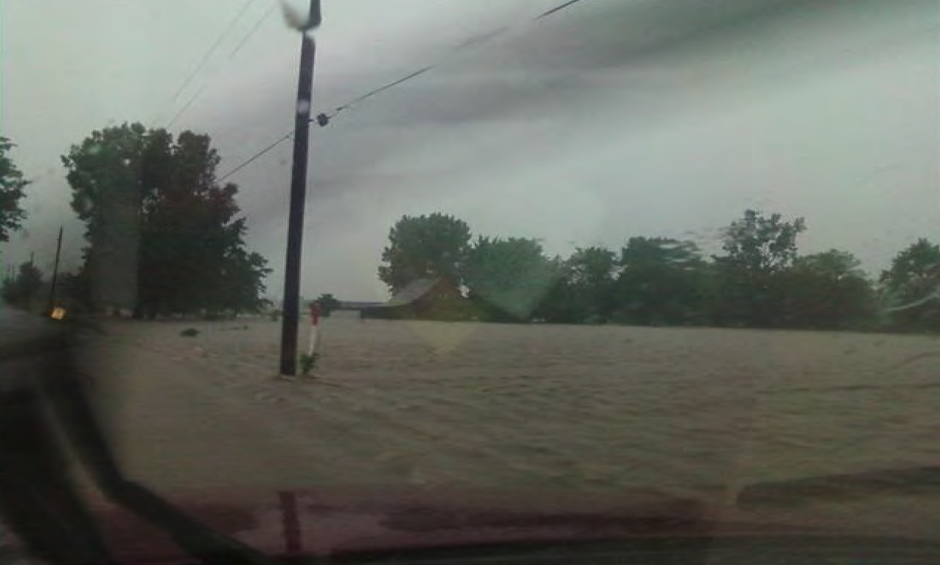
Areas that Flooded
Joe

Slide 13
What is the Main Focus of the Study?
Joe
Obtain public input
  Interview many of those directly affected in photos
  Interview Town personnel
  Held (2) open houses to gather and give information
Setup plan expectations to decrease upstream flooding while also benefitting those downstream (Consistent messaging)
Identify potential funding mechanisms

Slide 14
What was the Original Plan?
Joe
Purchase critical frequently flooded home to reduce overall plan costs (County)
  This saved $800,000 for the plan
Large regional detention basin as primary outlet for town (TBD)
Improved conveyance in critical areas (Town and County)

Slide 15
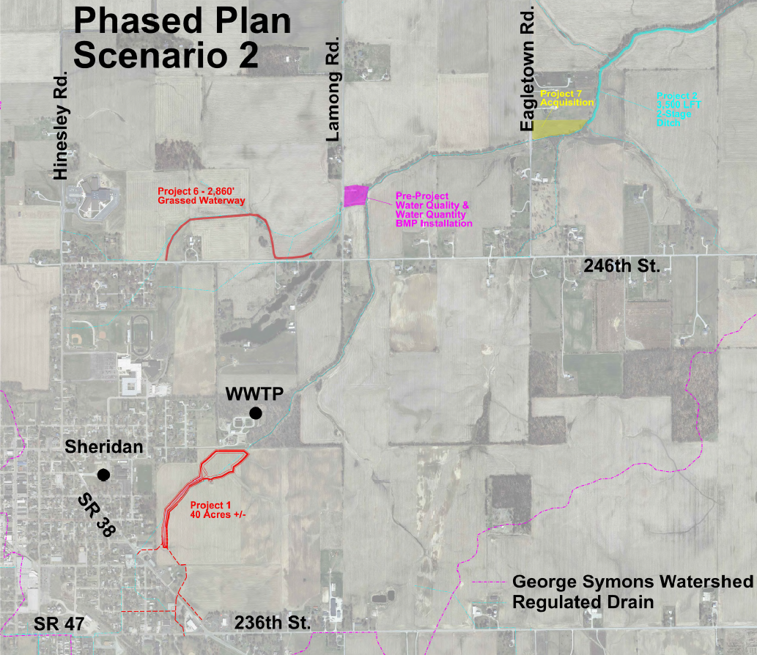
Map of the Original Plan?
Joe

Slide 16
How Has the Plan Been Implemented?
Joe
County ran bimonthly meetings with Town for over a year prior to real momentum starting
  Planning for 20-year execution of plan
Both parties looked for funding mechanisms for projects as appropriate
  County worked on regulated drain reconstruction assessments and looked for various assistance programs
  Town implemented storm water utility fee to pay for interior work
    This was also critical to assist in funding adequate outlet outside their jurisdiction (Project 1)
Decided to complete smaller project with visible impact first
Construction plans were being completed in preparation for funding opportunities
  Close coordination between county and town to ensure projects match up and are in the proper order

Slide 17
Angel Investors Found
Joe
Town of Sheridan
  OCRA CDBG storm water grant $500,000
Hamilton County
  USDA Rural Development Storm Water Capacity Fee ($3,000,000 +/-)
    First of its kind in the nation
    Includes engineering fees
    Includes property acquisition costs
    County performs work and Town pays for work
    40-Year loan at low interest rate
    Town to pay back through storm water utility fee
    Can roll in other storm water bonds
  INDOT and County Highway Department
    Per IC 36-9-27 pays for work crossing ROW

Slide 18
Storm Water Capacity Fee Explained -1
Joe
Community ‘A’
Community ‘A’ can purchase “capacity” from Community ‘B’ for increase storm sewer
Community ‘B’ can perform the project and is paid for it by Community ‘A’
Community ‘A’ takes out the loan with USDA
Work benefitting impacted community is outside of its jurisdiction
Community ‘B’
Undersized Outlet Managed by Community ‘B’ and impacting Community ‘A’

Slide 19
Storm Water Capacity Fee Explained -2
Joe
Community ‘A’
Community ‘B’ can purchase regional detention “capacity” from Community ‘A’
Community ‘A’ can perform the project and is paid for it by Community ‘B’
Community ‘B’ takes out the loan with USDA
Work benefitting impacted community is outside of its jurisdiction
Community ‘B’
Undersized Outlet Managed by Community ‘B’ and impacting Community ‘B’

Slide 20
Where is the Plan Right Now?
Joe

Slide 21
Where is the Plan Right Now?
Joe

Slide 22
Where is the Plan Right Now?
Joe
Completed or under construction projects
  South Drive
  Krause Phase 1
  Krause Phase 2
  Krause Phase 3
  Grassed Waterway
  Moore Property Acquisition
  Town storm sewer project
$3,750,000 +/- spent or under contract
Future Projects
  2-Stage Ditch
  Streambank stabilization
  Swan Property detention and Bridge upgrade
Over $2,000,000 remaining in plan
  40% higher than estimates 6 years ago

Slide 23
How Is Participation from so many Parties Managed?
Kent
County is in charge of regulated drains and has authority over any work discharging into them
  All storm water from Sheridan discharges to a regulated drain
County keeps all parties informed via e-mail and calls special in person meetings when needed
Very good leaders for all organizations involved
  They WANT to find a solution instead of blame

Slide 24
Lessons Learned
Kent
Educate, Educate, Educate
Communicate, Communicate, Communicate
Trust each other
Follow through
You should have only one primary advocate in each organization
  They can inform others and keep them on task
Eminent domain
  Easements are ok for pipe, but ditches, detention and spoils need to be full takes
Follow the plan
  Be flexible, but strategic with implementation
The longer you wait the more expensive it becomes

Slide 25
Questions?

