Slide 1
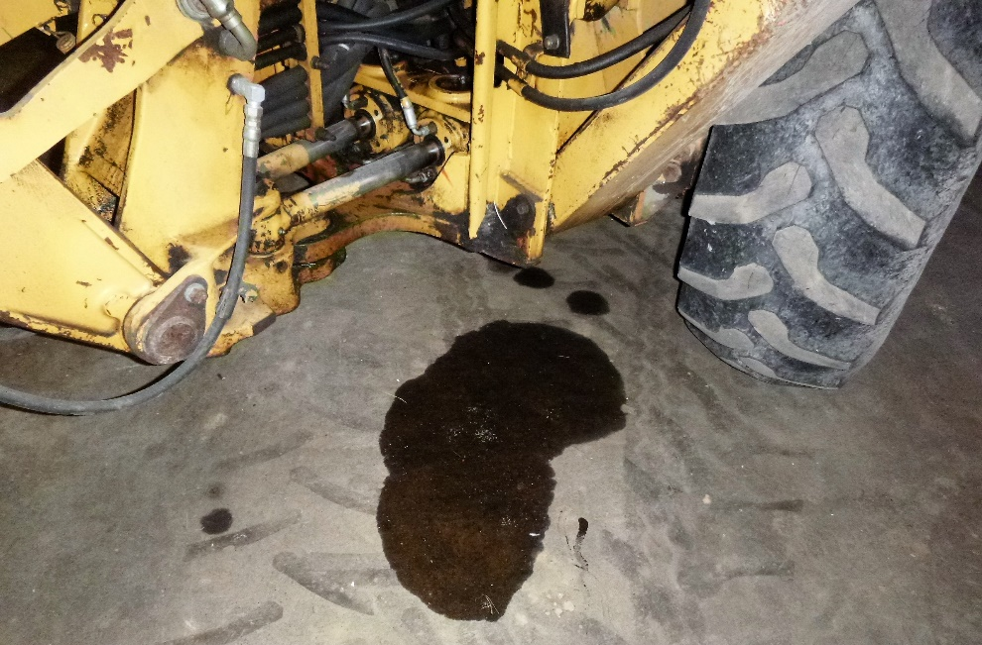
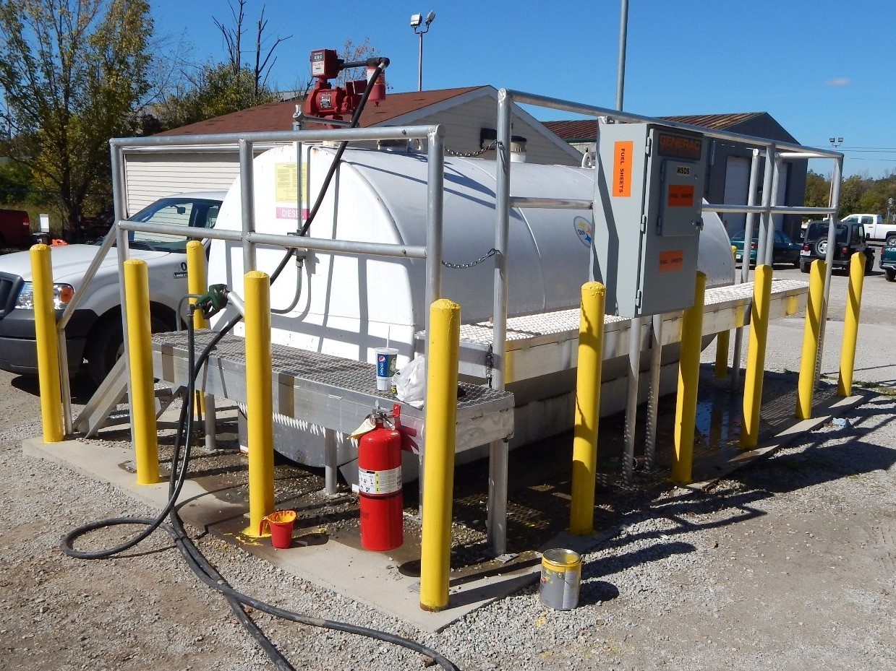
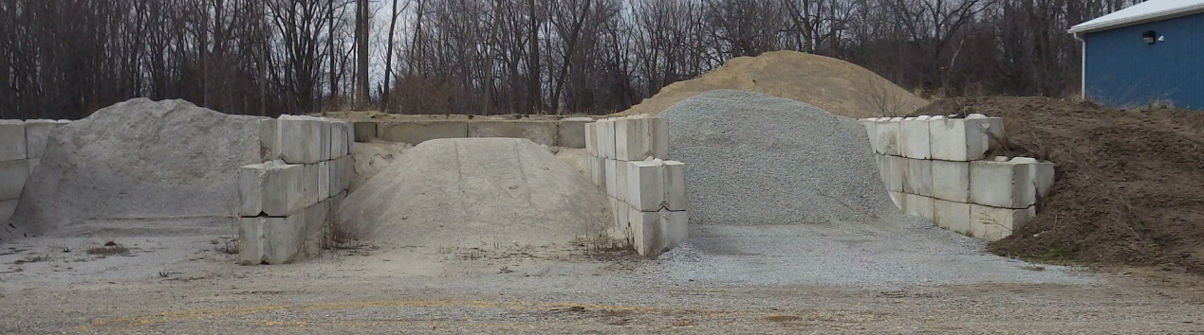
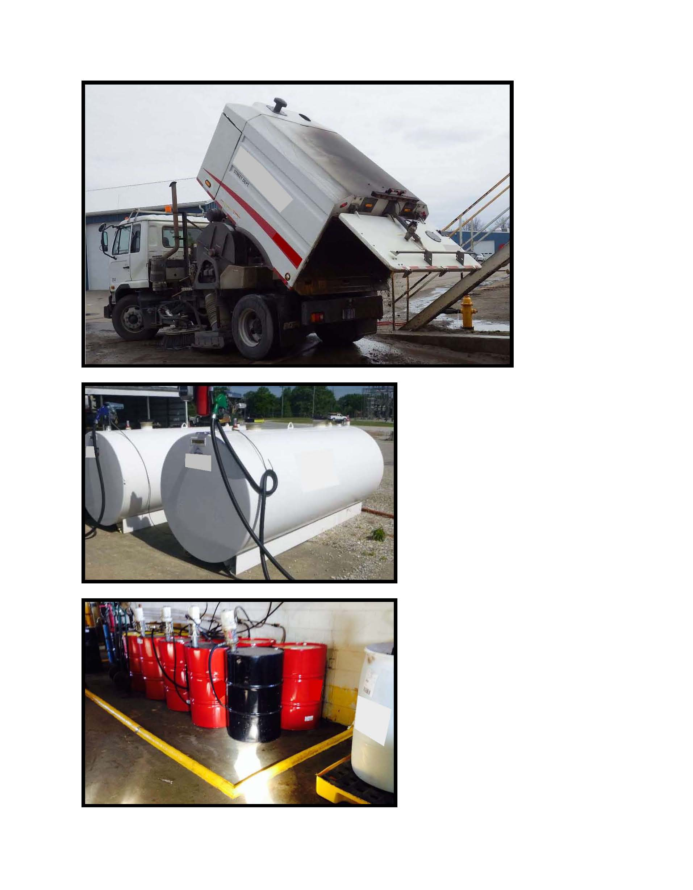
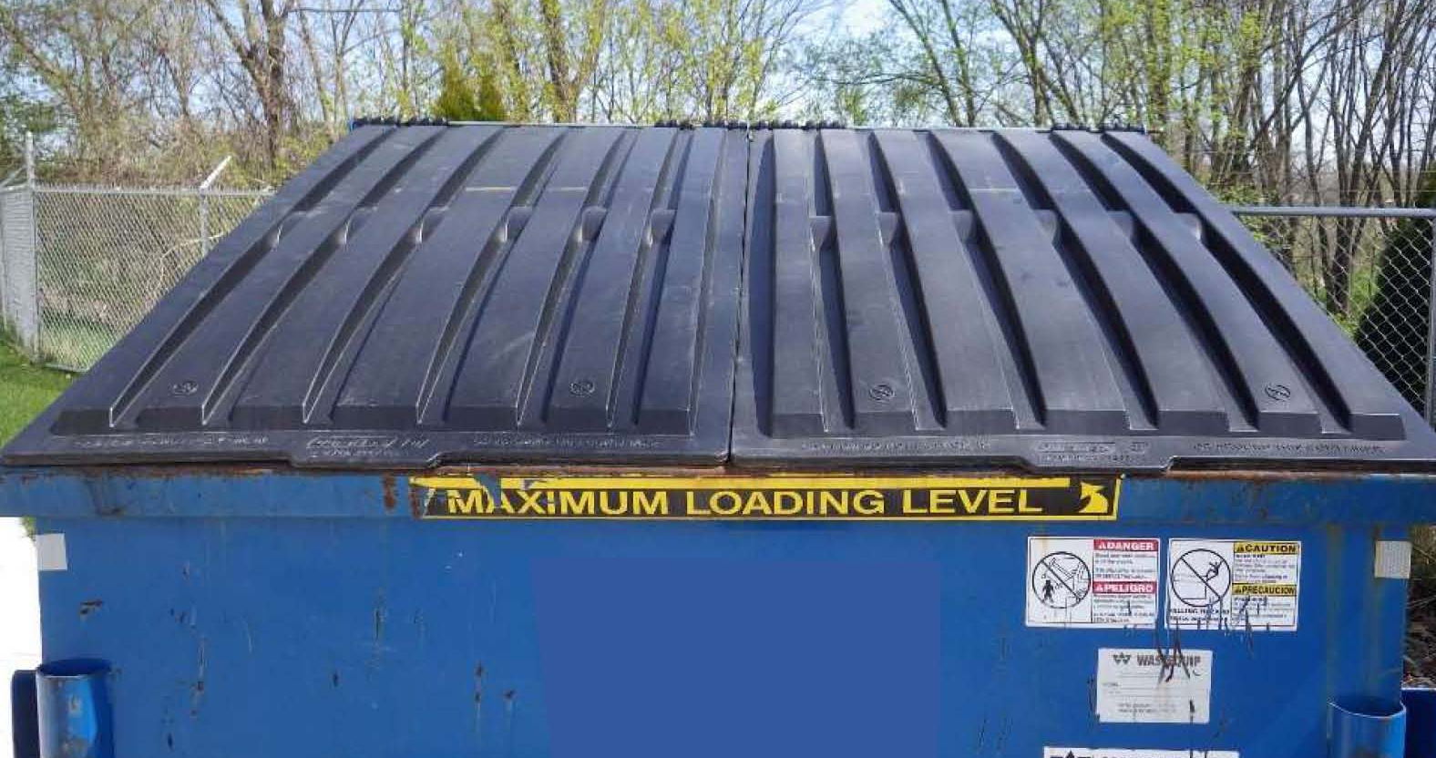

Slide 2
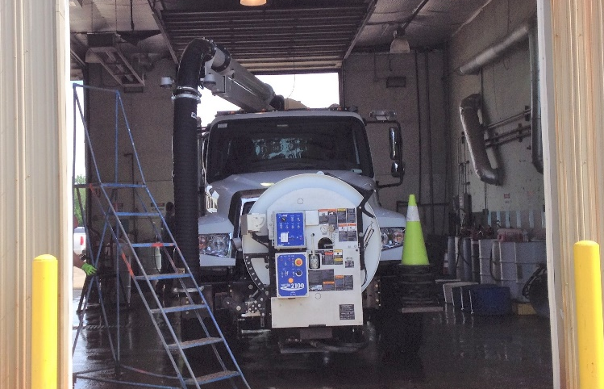
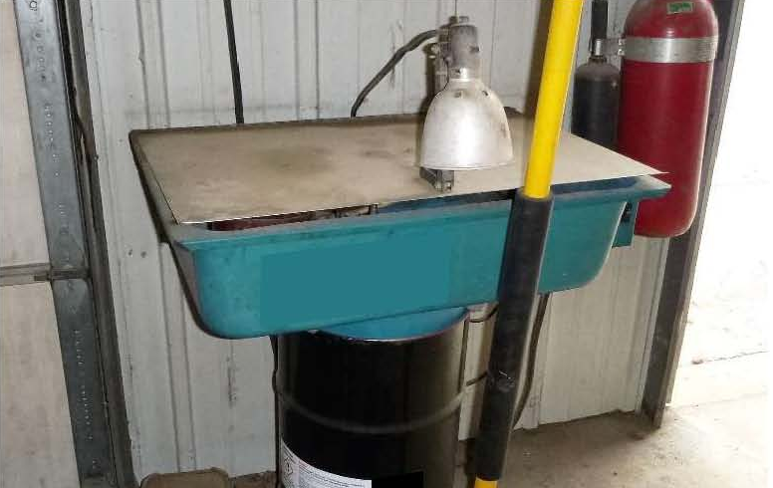
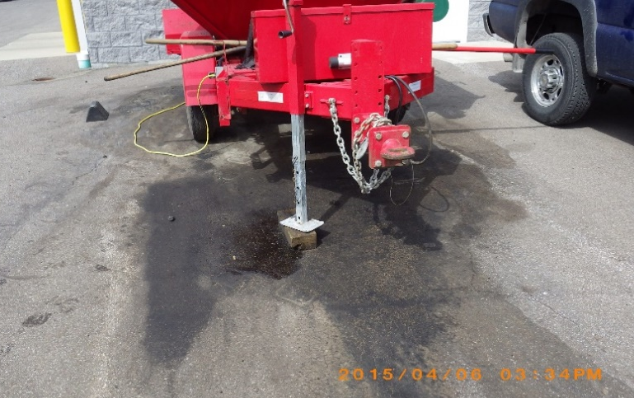
FLEET MAINTENANCE
Vehicle & Equipment Maintenance/Cleaning
Perform maintenance & cleaning in designated areas.
Wash waters should enter an oil/water separator, sanitary sewer, or collected by other means.
Maintenance oil leaks are to be cleaned up and not flushed to sanitary or storm sewers.
Parts Cleaning
Wash parts in designated cleaning stations.
Make sure parts fully drain before removing them.
Keep parts washer lid closed unless in use.
Leaking Vehicles
Park leaking vehicles under roof.
Use a drip pan or absorbents for collection.
Fueling Operations
Inspect fueling areas often and clean as needed.
Don’t top-off the fuel tank.
Know the locations of the emergency shut-off button & spill kit.

Slide 3
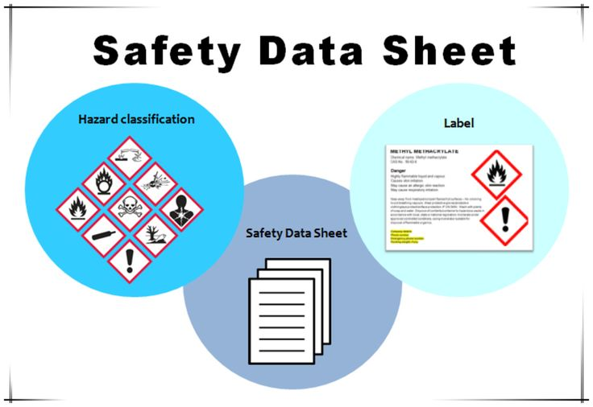
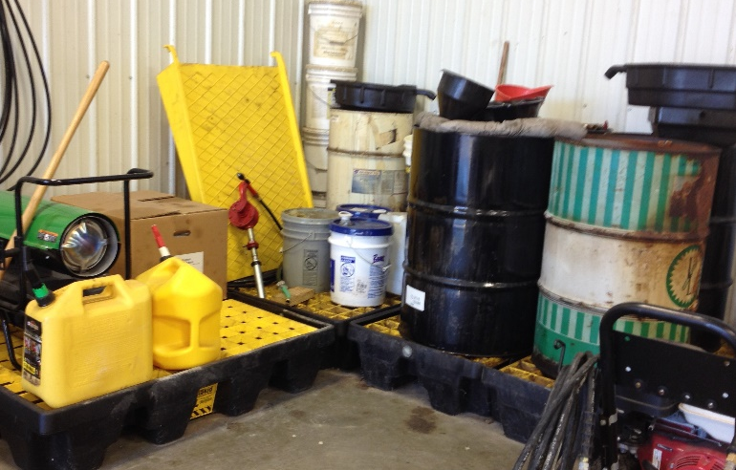
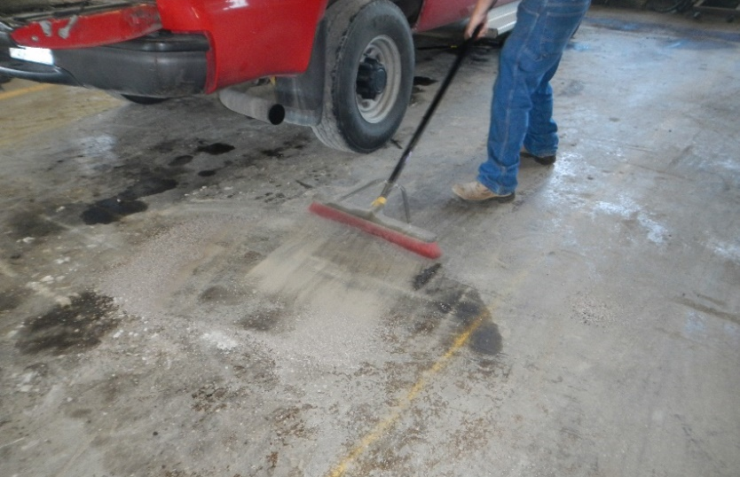
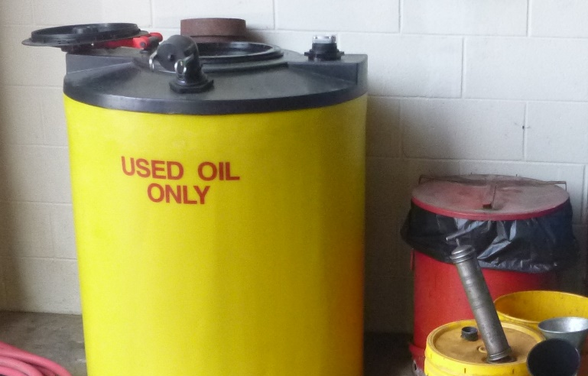
SPILL RESPONSE PROCEDURES
Instructions
& Procedures
Safety first!
Understand the chemical spilled before starting cleanup.
Follow cleanup instructions on the label or in the Safety Data Sheet (SDS).
Remove unnecessary personnel from area.
Contact Supervisor with questions.
Containment
Isolate & stop the leak if possible.
Collect spilled liquids with a drip pan or absorbents.
Protect inlets if spills may enter any drain.
Cover spills with a powder or solid material to prevent spreading by the wind.
Cleanup
Immediately cleanup non-hazardous spills with absorbents or a shop-vac.
Do NOT hose down spills to a sanitary or storm drain.
If the spill is too large, the Supervisor will call the Fire Department.
Document spill in site Stormwater Pollution Prevention Plan.
Disposal
If spilled material is usable, place in original or other marked container.
Recycle waste material if possible or follow proper disposal procedures.
Replace used absorbents as necessary.
Document disposal.

Slide 4
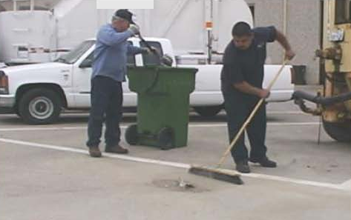
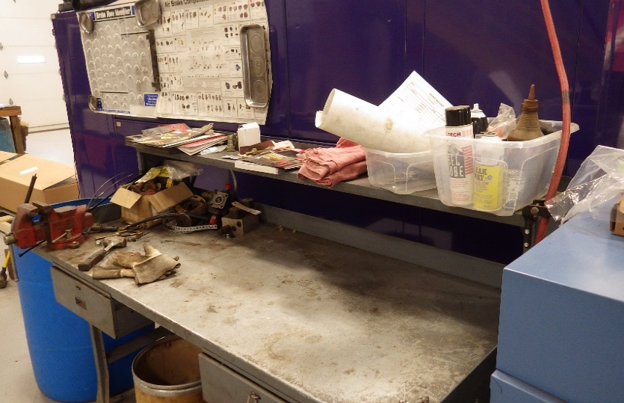
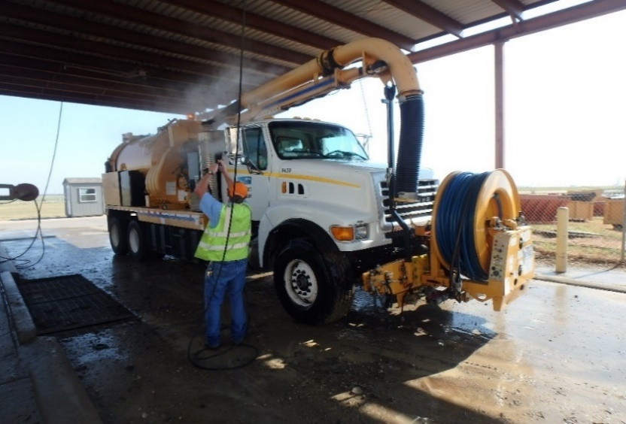
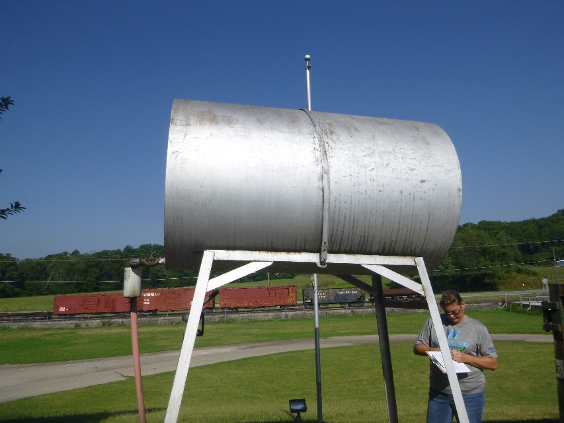
GENERAL HOUSEKEEPING
Cleaning Outside
Work Areas
Clean regularly. Take extra precaution if rain is forecasted.
Make sure that trash receptacles are emptied & closed as needed.
Collect & dispose of litter and debris on grounds and in inlets.
Cleaning
Shop
Clean up spent absorbents.
Use dry methods such as sweeping – don’t hose down the work area.
Use a drip pan or absorbents for leak collection.
Place all materials back in correct storage area or secondary containment when done using.
Vehicles, Equipment & Tools
Complete maintenance on vehicles & equipment in areas with oil/water separators/connected to the sanitary sewer.
Clean vehicles, tools & equipment in designated wash areas.
Visual
Inspections
Regularly inspect vehicles, equipment, hoses and seals for leaks.
Report malfunctioning equipment.

Slide 5
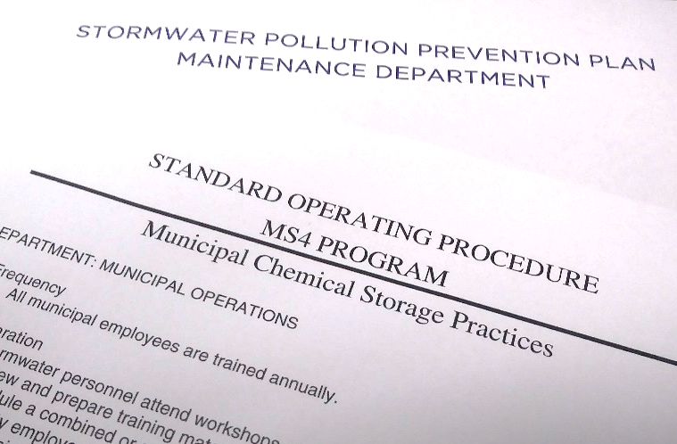
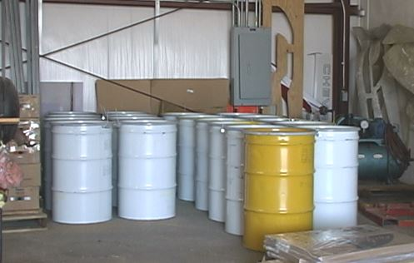
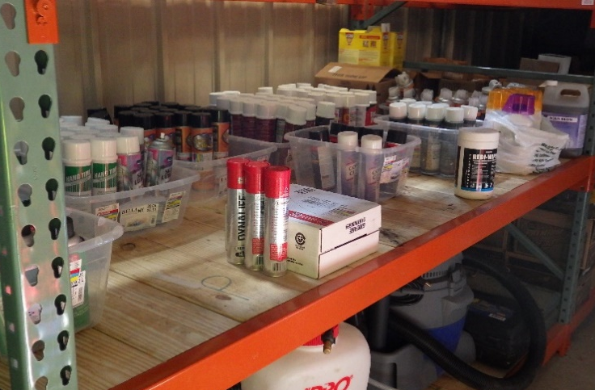
MATERIALS & CHEMICAL STORAGE
Instructions
& Procedures
Review Site SWPPP that identifies chemical storage locations and practices.
Review Standard Operating Procedures identifying appropriate waste disposal.
Inspect containers regularly as part of the site SWPPP.
Safe Material
Storage
Store away from high-traffic areas.
Store indoors in sealed containers; keep closed unless in use.
Use original or clearly labeled replacement containers.
Purchase chemicals only as needed.
Use nontoxic products when possible.
Chemical
Management
Mix chemicals on paved areas away from inlets.
Mix only what is needed.
Only apply chemicals if weather permits.
Avoid applying chemicals to sensitive areas such as waterbodies or inlets.
Store waste chemicals in closed containers, inside.
Appropriately label waste containers.
Spill-Trapping &
Containment Devices
Store chemicals away from floor drains and openings to the outside.
Provide spill control measures that will keep a spill in the building.
Store on secondary containment especially if located in a gravel area.
Do not store in-use chemicals outside.

Slide 6
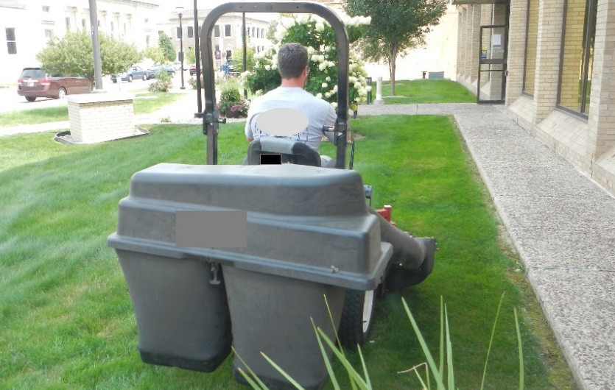
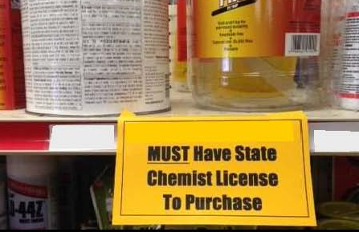
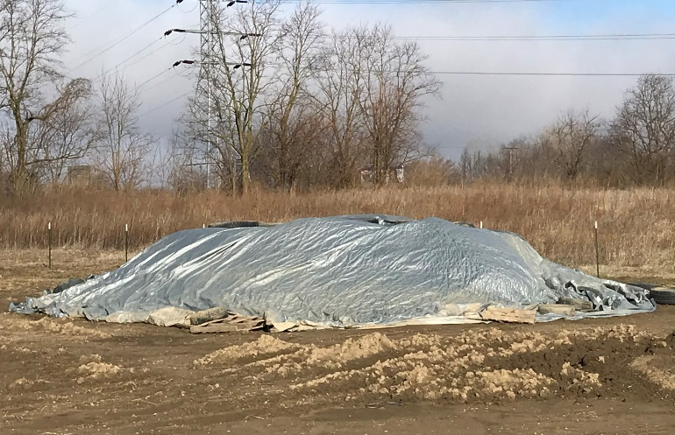
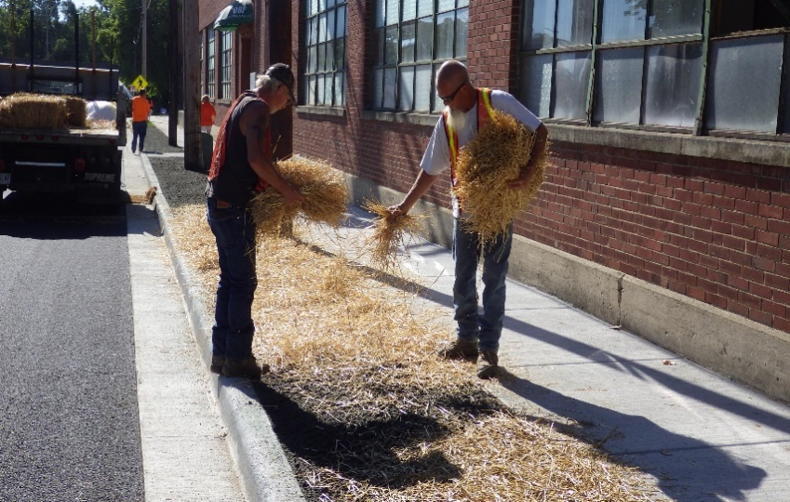
PARKS & GROUNDS MAINTENANCE
Clippings
& Trimmings
Mow the grass as high as possible (3” minimum).
Leave clippings on the lawn or collect for compost.
Collect trash before mowing.
Sweep or blow clippings & trimmings back onto the grass.
Do not blow clippings into a sanitary or storm sewer.
Chemical
Application
Follow instructions & procedures on the label.
Don’t apply pesticides or herbicides unless properly trained.
Apply only where needed & not in sensitive areas.
Compost, Mulch
& Stockpiles
Locate stockpiles away from flowing water/runoff.
Capture sediment using inlet bags/other methods.
Cover soil, sand & cold patch to prevent contact with stormwater.
Use compost as a soil amendment or shred leaves & add to flower beds as mulch.
Soil Management
Apply grass seed to prevent erosion.
Protect channels with turf reinforcement mats until vegetation is established.
Use temporary erosion control methods such as blankets, vegetation or mulching.

Slide 7
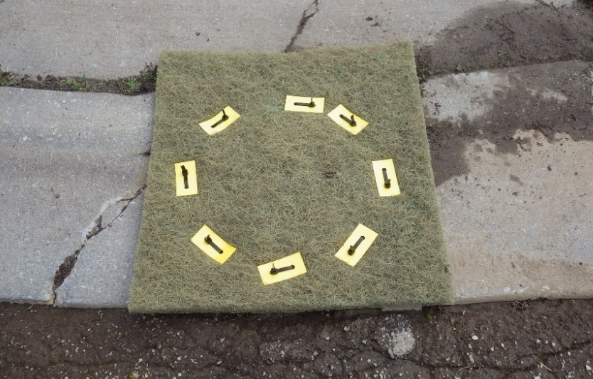
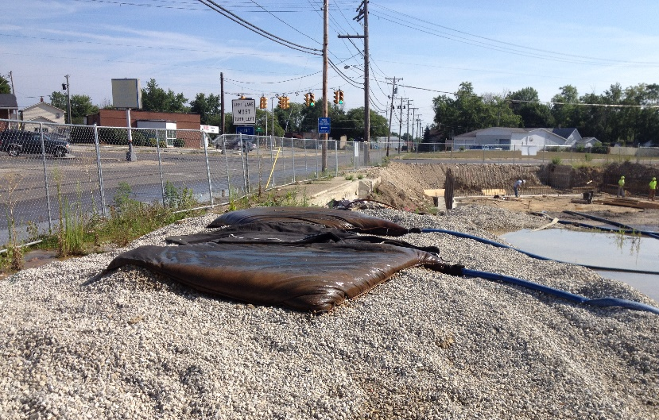
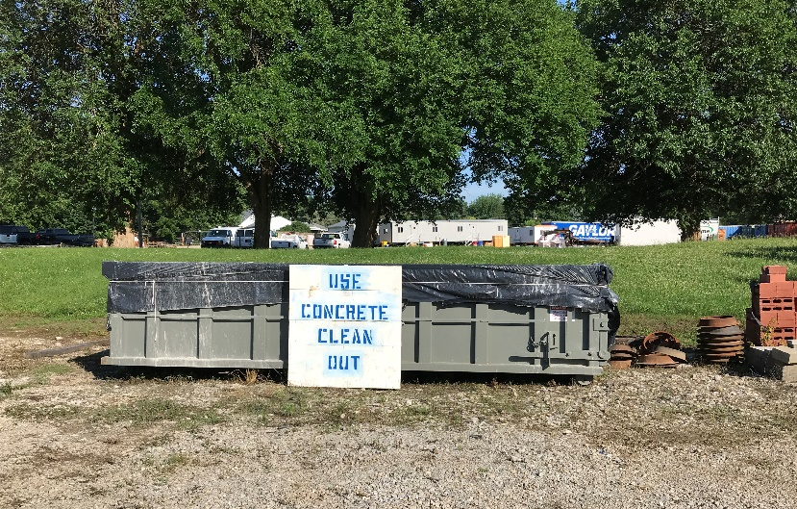
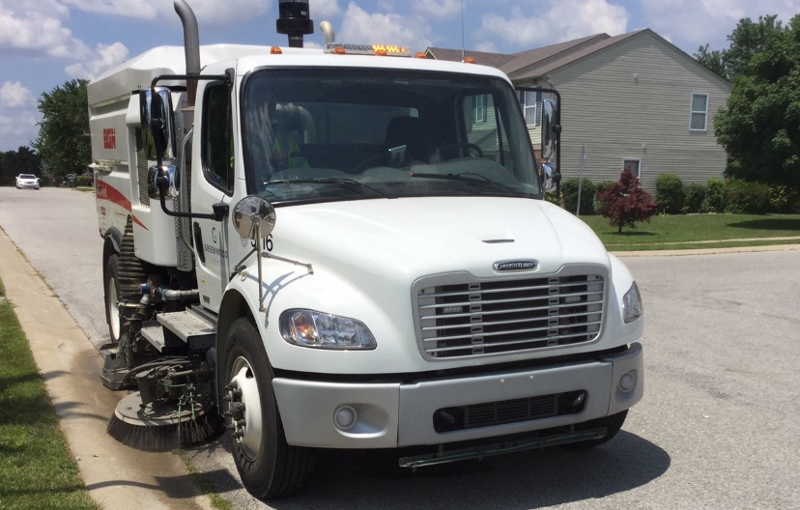
UTILITIES & STREET REPAIRS
Stormwater
Protection
Protect inlets (e.g. mats or bags) before starting work.
Use appropriate erosion and sediment control methods.
Inspect control methods as needed.
Apply grass seed and temporary mulch after construction activities to prevent erosion.
Construction
Operations
Potable water releases must be dechlorinated.
Use dewatering bags as needed.
Contain and vacuum slurry and cuttings from saw-cutting operations.
Store materials under cover and in secondary containment.
Have absorbent materials on hand in case of a spill.
Repair
Operations
Mix only the necessary amount of asphalt.
Sweep up and properly dispose of all spent asphalt material.
Use biodegradable products instead of diesel.
Use and maintain concrete washouts areas.
Cleanup
Cleanup sediment from
the street and inlet protection.
Use a street sweeper if needed.
Do not wash sediments down any drain.
Dispose of wastes appropriately.

